Slide 1
Unit V – Data Storage and Querying
Storage and File Structure: Overview of physical storage media, magnetic disk and flash storage, RAID, tertiary storage, File Organization, Organization of Records in Files, Data-Dictionary Storage, Database Buffer.
Indexing and hashing: Ordered Indices, B+-Tree Index Files, B+-Tree Extensions, Multiple-Key Access, Static hashing, Dynamic Hashing, Comparison of Ordered Indexing and Hashing, Bitmap Indices, Index Definition in SQL.
Query processing and Optimization: Measures of Query Cost, selection Operations, sorting, Join operations, Other Operations, Evaluation of Expressions. Transformation of Relational Expressions, Estimating Statistics of Expression Results, choice of Evaluation plans and Materialized views

Slide 2
Chapter 10: Storage and File Structure

Slide 3
Chapter 10: Storage and File Structure
Overview of Physical Storage Media
Magnetic Disks
RAID
Tertiary Storage
Storage Access
File Organization
Organization of Records in Files
Data-Dictionary Storage

Slide 4
Classification of Physical Storage Media
Speed with which data can be accessed
Cost per unit of data
Reliability
data loss on power failure or system crash
physical failure of the storage device
Can differentiate storage into:
volatile storage: loses contents when power is switched off
non-volatile storage:
Contents persist even when power is switched off.
Includes secondary and tertiary storage, as well as batter- backed up main-memory.

Slide 5
Physical Storage Media
Cache – fastest and most costly form of storage; volatile; managed by the computer system hardware.
Main memory:
fast access (10s to 100s of nanoseconds; 1 nanosecond = 10^{–9} seconds)
generally too small (or too expensive) to store the entire database
capacities of up to a few Gigabytes widely used currently
Capacities have gone up and per-byte costs have decreased steadily and rapidly (roughly factor of 2 every 2 to 3 years)
Volatile — contents of main memory are usually lost if a power failure or system crash occurs.

Slide 6
Physical Storage Media (Cont.)
Flash memory
Data survives power failure
Data can be written at a location only once, but location can be erased and written to again
Can support only a limited number (10K – 1M) of write/erase cycles.
Erasing of memory has to be done to an entire bank of memory
Reads are roughly as fast as main memory
But writes are slow (few microseconds), erase is slower
Widely used in embedded devices such as digital cameras, phones, and USB keys

Slide 7
Physical Storage Media (Cont.)
Magnetic-disk
Data is stored on spinning disk, and read/written magnetically
Primary medium for the long-term storage of data; typically stores entire database.
Data must be moved from disk to main memory for access, and written back for storage
Much slower access than main memory (more on this later)
direct-access – possible to read data on disk in any order, unlike magnetic tape
Capacities range up to roughly 1.5 TB as of 2009
Much larger capacity and cost/byte than main memory/flash memory
Growing constantly and rapidly with technology improvements (factor of 2 to 3 every 2 years)
Survives power failures and system crashes
disk failure can destroy data, but is rare

Slide 8
Physical Storage Media (Cont.)
Optical storage
non-volatile, data is read optically from a spinning disk using a laser
CD-ROM (640 MB) and DVD (4.7 to 17 GB) most popular forms
Blu-ray disks: 27 GB to 54 GB
Write-one, read-many (WORM) optical disks used for archival storage (CD-R, DVD-R, DVD+R)
Multiple write versions also available (CD-RW, DVD-RW, DVD+RW, and DVD-RAM)
Reads and writes are slower than with magnetic disk
Juke-box systems, with large numbers of removable disks, a few drives, and a mechanism for automatic loading/unloading of disks available for storing large volumes of data

Slide 9
Physical Storage Media (Cont.)
Tape storage
non-volatile, used primarily for backup (to recover from disk failure), and for archival data
sequential-access – much slower than disk
very high capacity (40 to 300 GB tapes available)
tape can be removed from drive ⇒ storage costs much cheaper than disk, but drives are expensive
Tape jukeboxes available for storing massive amounts of data
hundreds of terabytes (1 terabyte = 10⁹ bytes) to even multiple petabytes (1 petabyte = 10¹² bytes)

Slide 10
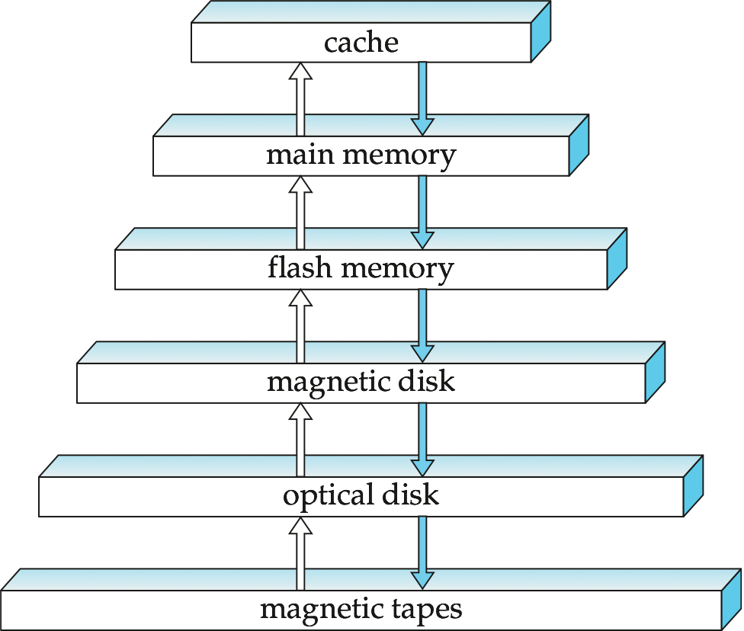
Storage Hierarchy

Slide 11
Storage Hierarchy (Cont.)
primary storage: Fastest media but volatile (cache, main memory).
secondary storage: next level in hierarchy, non-volatile, moderately fast access time
also called on-line storage
E.g. flash memory, magnetic disks
tertiary storage: lowest level in hierarchy, non-volatile, slow access time
also called off-line storage
E.g. magnetic tape, optical storage

Slide 12
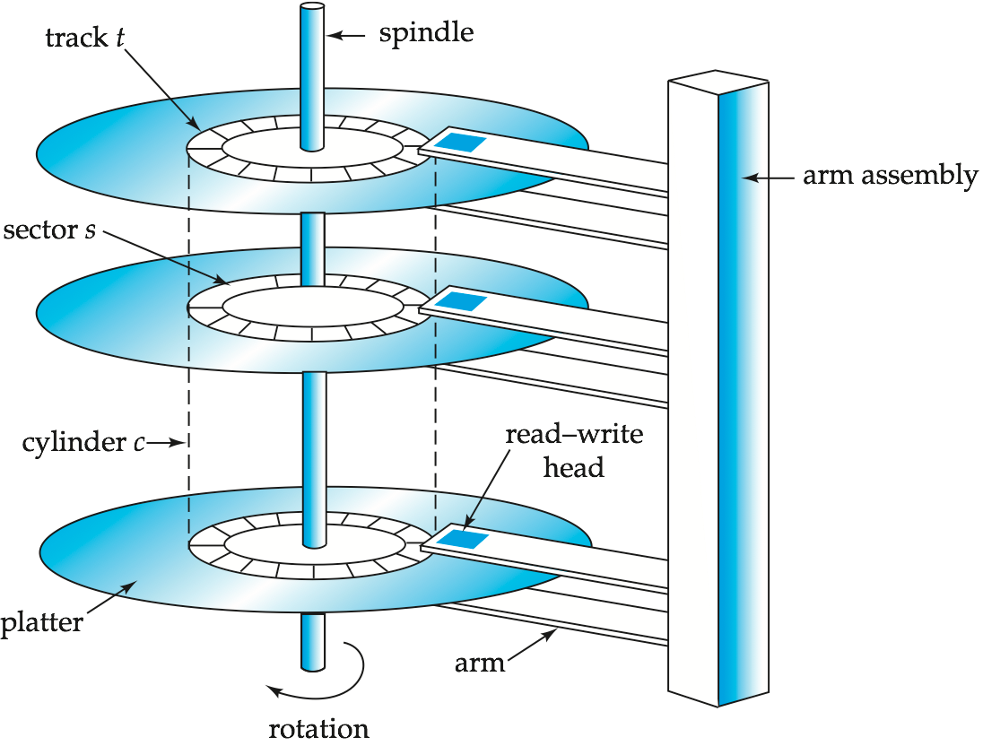
Magnetic Hard Disk Mechanism
NOTE: Diagram is schematic, and simplifies the structure of actual disk drives

Slide 13
Magnetic Disks
Read-write head
Positioned very close to the platter surface (almost touching it)
Reads or writes magnetically encoded information.
Surface of platter divided into circular tracks
Over 50K-100K tracks per platter on typical hard disks
Each track is divided into sectors.
A sector is the smallest unit of data that can be read or written.
Sector size typically 512 bytes
Typical sectors per track: 500 to 1000 (on inner tracks) to 1000 to 2000 (on outer tracks)
To read/write a sector
disk arm swings to position head on right track
platter spins continually; data is read/written as sector passes under head
Head-disk assemblies
multiple disk platters on a single spindle (1 to 5 usually)
one head per platter, mounted on a common arm.
Cylinder i consists of i^{th} track of all the platters

Slide 14
Magnetic Disks (Cont.)
Earlier generation disks were susceptible to head-crashes
Surface of earlier generation disks had metal-oxide coatings which would disintegrate on head crash and damage all data on disk
Current generation disks are less susceptible to such disastrous failures, although individual sectors may get corrupted
Disk controller – interfaces between the computer system and the disk drive hardware.
accepts high-level commands to read or write a sector
initiates actions such as moving the disk arm to the right track and actually reading or writing the data
Computes and attaches checksums to each sector to verify that data is read back correctly
If data is corrupted, with very high probability stored checksum won’t match recomputed checksum
Ensures successful writing by reading back sector after writing it
Performs remapping of bad sectors

Slide 15
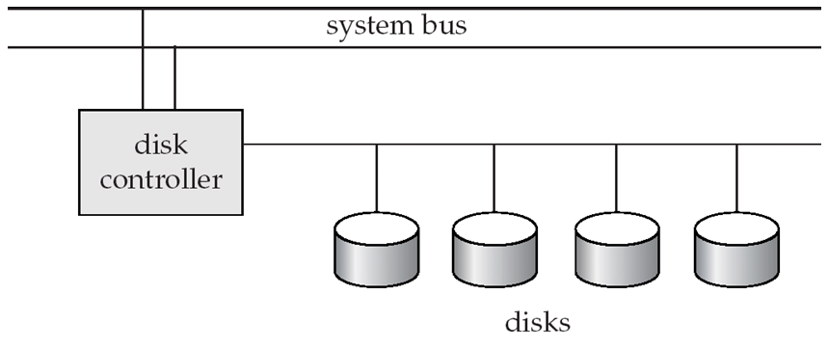
Disk Subsystem
Multiple disks connected to a computer system through a controller
Controllers functionality (checksum, bad sector remapping) often carried out by individual disks; reduces load on controller
Disk interface standards families
ATA (AT adaptor) range of standards
SATA (Serial ATA)
SCSI (Small Computer System Interconnect) range of standards
SAS (Serial Attached SCSI)
Several variants of each standard (different speeds and capabilities)

Slide 16
Disk Subsystem
Disks usually connected directly to computer system
In Storage Area Networks (SAN), a large number of disks are connected by a high-speed network to a number of servers
In Network Attached Storage (NAS) networked storage provides a file system interface using networked file system protocol, instead of providing a disk system interface

Slide 17
Performance Measures of Disks
Access time – the time it takes from when a read or write request is issued to when data transfer begins. Consists of:
Seek time – time it takes to reposition the arm over the correct track.
Average seek time is 1/2 the worst case seek time.
Would be 1/3 if all tracks had the same number of sectors, and we ignore the time to start and stop arm movement
4 to 10 milliseconds on typical disks
Rotational latency – time it takes for the sector to be accessed to appear under the head.
Average latency is 1/2 of the worst case latency.
4 to 11 milliseconds on typical disks (5400 to 15000 r.p.m.)
Data-transfer rate – the rate at which data can be retrieved from or stored to the disk.
25 to 100 MB per second max rate, lower for inner tracks
Multiple disks may share a controller, so rate that controller can handle is also important
E.g. SATA: 150 MB/sec, SATA-II 3Gb (300 MB/sec)
Ultra 320 SCSI: 320 MB/s, SAS (3 to 6 Gb/sec)
Fiber Channel (FC2Gb or 4Gb): 256 to 512 MB/s

Slide 18
Performance Measures (Cont.)
Mean time to failure (MTTF) – the average time the disk is expected to run continuously without any failure.
Typically 3 to 5 years
Probability of failure of new disks is quite low, corresponding to a “theoretical MTTF” of 500,000 to 1,200,000 hours for a new disk
E.g., an MTTF of 1,200,000 hours for a new disk means that given 1000 relatively new disks, on an average one will fail every 1200 hours
MTTF decreases as disk ages

Slide 19
Optimization of Disk-Block Access
Block – a contiguous sequence of sectors from a single track
data is transferred between disk and main memory in blocks
sizes range from 512 bytes to several kilobytes
Smaller blocks: more transfers from disk
Larger blocks: more space wasted due to partially filled blocks
Typical block sizes today range from 4 to 16 kilobytes
Disk-arm-scheduling algorithms order pending accesses to tracks so that disk arm movement is minimized
elevator algorithm:
R6
R3
R1
R5
R2
R4
Inner track
Outer track

Slide 20
Optimization of Disk Block Access (Cont.)
File organization – optimize block access time by organizing the blocks to correspond to how data will be accessed
E.g. Store related information on the same or nearby cylinders.
Files may get fragmented over time
E.g. if data is inserted to/deleted from the file
Or free blocks on disk are scattered, and newly created file has its blocks scattered over the disk
Sequential access to a fragmented file results in increased disk arm movement
Some systems have utilities to defragment the file system, in order to speed up file access

Slide 21
Optimization of Disk Block Access (Cont.)
Nonvolatile write buffers speed up disk writes by writing blocks to a non-volatile RAM buffer immediately
Non-volatile RAM: battery backed up RAM or flash memory
Even if power fails, the data is safe and will be written to disk when power returns
Controller then writes to disk whenever the disk has no other requests or request has been pending for some time
Database operations that require data to be safely stored before continuing can continue without waiting for data to be written to disk
Writes can be reordered to minimize disk arm movement
Log disk – a disk devoted to writing a sequential log of block updates
Used exactly like nonvolatile RAM
Write to log disk is very fast since no seeks are required
No need for special hardware (NV-RAM)
File systems typically reorder writes to disk to improve performance
Journaling file systems write data in safe order to NV-RAM or log disk
Reordering without journaling: risk of corruption of file system data

Slide 22
Flash Storage
NOR flash vs NAND flash
NAND flash
used widely for storage, since it is much cheaper than NOR flash
requires page-at-a-time read (page: 512 bytes to 4 KB)
transfer rate around 20 MB/sec
solid state disks: use multiple flash storage devices to provide higher transfer rate of 100 to 200 MB/sec
erase is very slow (1 to 2 millisecs)
erase block contains multiple pages
remapping of logical page addresses to physical page addresses avoids waiting for erase
translation table tracks mapping
also stored in a label field of flash page
remapping carried out by flash translation layer
after 100,000 to 1,000,000 erases, erase block becomes unreliable and cannot be used
wear leveling

Slide 23
RAID
RAID: Redundant Arrays of Independent Disks
disk organization techniques that manage a large numbers of disks, providing a view of a single disk of
high capacity and high speed by using multiple disks in parallel,
high reliability by storing data redundantly, so that data can be recovered even if a disk fails
The chance that some disk out of a set of N disks will fail is much higher than the chance that a specific single disk will fail.
E.g., a system with 100 disks, each with MTTF of 100,000 hours (approx. 11 years), will have a system MTTF of 1000 hours (approx. 41 days)
Techniques for using redundancy to avoid data loss are critical with large numbers of disks
Originally a cost-effective alternative to large, expensive disks
I in RAID originally stood for ``inexpensive’’
Today RAIDs are used for their higher reliability and bandwidth.
The “I” is interpreted as independent

Slide 24
Improvement of Reliability via Redundancy
Redundancy – store extra information that can be used to rebuild information lost in a disk failure
E.g., Mirroring (or shadowing)
Duplicate every disk. Logical disk consists of two physical disks.
Every write is carried out on both disks
Reads can take place from either disk
If one disk in a pair fails, data still available in the other
Data loss would occur only if a disk fails, and its mirror disk also fails before the system is repaired
Probability of combined event is very small
Except for dependent failure modes such as fire or building collapse or electrical power surges
Mean time to data loss depends on mean time to failure, and mean time to repair
E.g. MTTF of 100,000 hours, mean time to repair of 10 hours gives mean time to data loss of 500*10⁶ hours (or 57,000 years) for a mirrored pair of disks (ignoring dependent failure modes)

Slide 25
Improvement in Performance via Parallelism
Two main goals of parallelism in a disk system:
1. Load balance multiple small accesses to increase throughput
2. Parallelize large accesses to reduce response time.
Improve transfer rate by striping data across multiple disks.
Bit-level striping – split the bits of each byte across multiple disks
In an array of eight disks, write bit i of each byte to disk i.
Each access can read data at eight times the rate of a single disk.
But seek/access time worse than for a single disk
Bit level striping is not used much any more
Block-level striping – with n disks, block i of a file goes to disk (i mod n) + 1
Requests for different blocks can run in parallel if the blocks reside on different disks
A request for a long sequence of blocks can utilize all disks in parallel

Slide 26
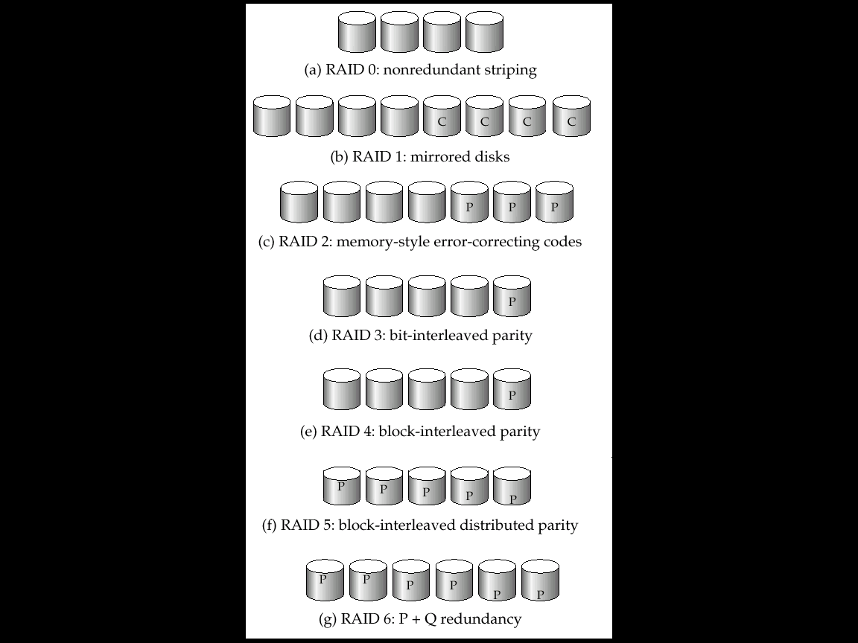
RAID Levels
Schemes to provide redundancy at lower cost by using disk striping combined with parity bits
Different RAID organizations, or RAID levels, have differing cost, performance and reliability characteristics
RAID Level 0: Block striping; non-redundant.
Used in high-performance applications where data loss is not critical.
RAID Level 1: Mirrored disks with block striping
Offers best write performance.
Popular for applications such as storing log files in a database system.

Slide 27
RAID Levels (Cont.)
RAID Level 2: Memory-Style Error-Correcting-Codes (ECC) with bit striping.
RAID Level 3: Bit-Interleaved Parity
a single parity bit is enough for error correction, not just detection, since we know which disk has failed
When writing data, corresponding parity bits must also be computed and written to a parity bit disk
To recover data in a damaged disk, compute XOR of bits from other disks (including parity bit disk)

Slide 28
RAID Levels (Cont.)
RAID Level 3 (Cont.)
Faster data transfer than with a single disk, but fewer I/Os per second since every disk has to participate in every I/O.
Subsumes Level 2 (provides all its benefits, at lower cost).
RAID Level 4: Block-Interleaved Parity; uses block-level striping, and keeps a parity block on a separate disk for corresponding blocks from N other disks.
When writing data block, corresponding block of parity bits must also be computed and written to parity disk
To find value of a damaged block, compute XOR of bits from corresponding blocks (including parity block) from other disks.

Slide 29
RAID Levels (Cont.)
RAID Level 4 (Cont.)
Provides higher I/O rates for independent block reads than Level 3
block read goes to a single disk, so blocks stored on different disks can be read in parallel
Provides high transfer rates for reads of multiple blocks than no-striping
Before writing a block, parity data must be computed
Can be done by using old parity block, old value of current block and new value of current block (2 block reads + 2 block writes)
Or by recomputing the parity value using the new values of blocks corresponding to the parity block
More efficient for writing large amounts of data sequentially
Parity block becomes a bottleneck for independent block writes since every block write also writes to parity disk

Slide 30
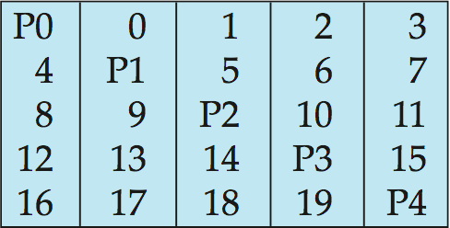
RAID Levels (Cont.)
RAID Level 5: Block-Interleaved Distributed Parity; partitions data and parity among all N + 1 disks, rather than storing data in N disks and parity in 1 disk.
E.g., with 5 disks, parity block for nth set of blocks is stored on disk (n mod 5) + 1, with the data blocks stored on the other 4 disks.

Slide 31
RAID Levels (Cont.)
RAID Level 5 (Cont.)
Higher I/O rates than Level 4.
Block writes occur in parallel if the blocks and their parity blocks are on different disks.
Subsumes Level 4: provides same benefits, but avoids bottleneck of parity disk.
RAID Level 6: P+Q Redundancy scheme; similar to Level 5, but stores extra redundant information to guard against multiple disk failures.
Better reliability than Level 5 at a higher cost; not used as widely.

Slide 32
Choice of RAID Level
Factors in choosing RAID level
Monetary cost
Performance: Number of I/O operations per second, and bandwidth during normal operation
Performance during failure
Performance during rebuild of failed disk
Including time taken to rebuild failed disk
RAID 0 is used only when data safety is not important
E.g. data can be recovered quickly from other sources
Level 2 and 4 never used since they are subsumed by 3 and 5
Level 3 is not used anymore since bit-striping forces single block reads to access all disks, wasting disk arm movement, which block striping (level 5) avoids
Level 6 is rarely used since levels 1 and 5 offer adequate safety for most applications

Slide 33
Choice of RAID Level (Cont.)
Level 1 provides much better write performance than level 5
Level 5 requires at least 2 block reads and 2 block writes to write a single block, whereas Level 1 only requires 2 block writes
Level 1 preferred for high update environments such as log disks
Level 1 had higher storage cost than level 5
disk drive capacities increasing rapidly (50%/year) whereas disk access times have decreased much less (x 3 in 10 years)
I/O requirements have increased greatly, e.g. for Web servers
When enough disks have been bought to satisfy required rate of I/O, they often have spare storage capacity
so there is often no extra monetary cost for Level 1!
Level 5 is preferred for applications with low update rate, and large amounts of data
Level 1 is preferred for all other applications

Slide 34
Hardware Issues
Software RAID: RAID implementations done entirely in software, with no special hardware support
Hardware RAID: RAID implementations with special hardware
Use non-volatile RAM to record writes that are being executed
Beware: power failure during write can result in corrupted disk
E.g. failure after writing one block but before writing the second in a mirrored system
Such corrupted data must be detected when power is restored
Recovery from corruption is similar to recovery from failed disk
NV-RAM helps to efficiently detected potentially corrupted blocks
Otherwise all blocks of disk must be read and compared with mirror/parity block

Slide 35
Hardware Issues (Cont.)
Latent failures: data successfully written earlier gets damaged
can result in data loss even if only one disk fails
Data scrubbing:
continually scan for latent failures, and recover from copy/parity
Hot swapping: replacement of disk while system is running, without power down
Supported by some hardware RAID systems,
reduces time to recovery, and improves availability greatly
Many systems maintain spare disks which are kept online, and used as replacements for failed disks immediately on detection of failure
Reduces time to recovery greatly
Many hardware RAID systems ensure that a single point of failure will not stop the functioning of the system by using
Redundant power supplies with battery backup
Multiple controllers and multiple interconnections to guard against controller/interconnection failures

Slide 36
Optical Disks
Compact disk-read only memory (CD-ROM)
Removable disks, 640 MB per disk
Seek time about 100 msec (optical read head is heavier and slower)
Higher latency (3000 RPM) and lower data-transfer rates (3-6 MB/s) compared to magnetic disks
Digital Video Disk (DVD)
DVD-5 holds 4.7 GB , and DVD-9 holds 8.5 GB
DVD-10 and DVD-18 are double sided formats with capacities of 9.4 GB and 17 GB
Blu-ray DVD: 27 GB (54 GB for double sided disk)
Slow seek time, for same reasons as CD-ROM
Record once versions (CD-R and DVD-R) are popular
data can only be written once, and cannot be erased.
high capacity and long lifetime; used for archival storage
Multi-write versions (CD-RW, DVD-RW, DVD+RW and DVD-RAM) also available

Slide 37
Magnetic Tapes
Hold large volumes of data and provide high transfer rates
Few GB for DAT (Digital Audio Tape) format, 10-40 GB with DLT (Digital Linear Tape) format, 100 GB+ with Ultrium format, and 330 GB with Ampex helical scan format
Transfer rates from few to 10s of MB/s
Tapes are cheap, but cost of drives is very high
Very slow access time in comparison to magnetic and optical disks
limited to sequential access.
Some formats (Accelis) provide faster seek (10s of seconds) at cost of lower capacity
Used mainly for backup, for storage of infrequently used information, and as an off-line medium for transferring information from one system to another.
Tape jukeboxes used for very large capacity storage
Multiple petabyes (10¹⁵ bytes)

Slide 38
File Organization, Record Organization and Storage Access

Slide 39
File Organization
The database is stored as a collection of files. Each file is a sequence of records. A record is a sequence of fields.
One approach:
assume record size is fixed
each file has records of one particular type only
different files are used for different relations
This case is easiest to implement; will consider variable length records later.

Slide 40
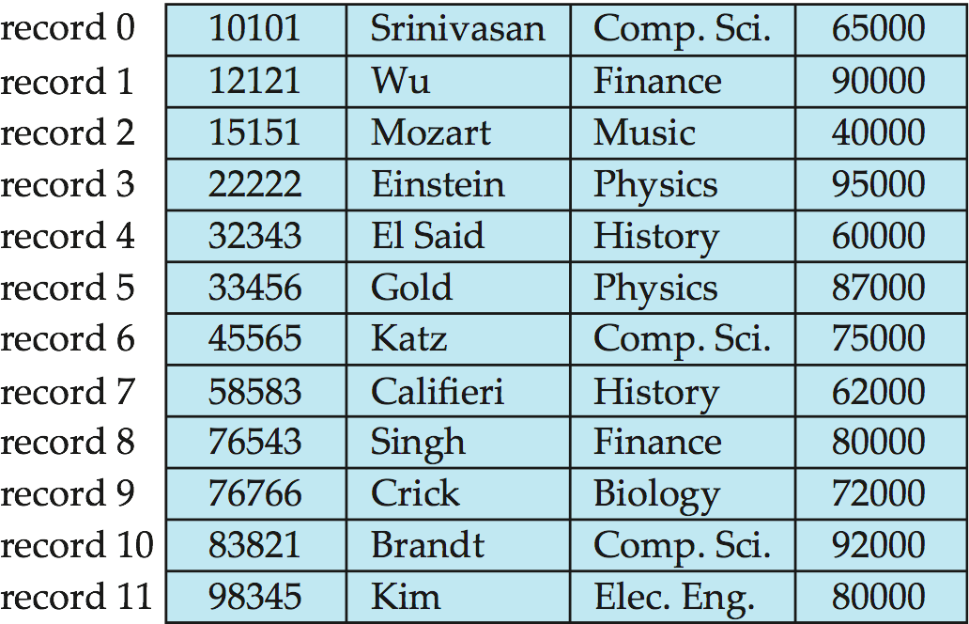
Fixed-Length Records
Simple approach:
Store record i starting from byte n ∗ (i – 1), where n is the size of each record.
Record access is simple but records may cross blocks
Modification: do not allow records to cross block boundaries
Deletion of record i: alternatives:
move records i + 1, . . ., n to i, . . . , n – 1
move record n to i
do not move records, but link all free records on a free list

Slide 41
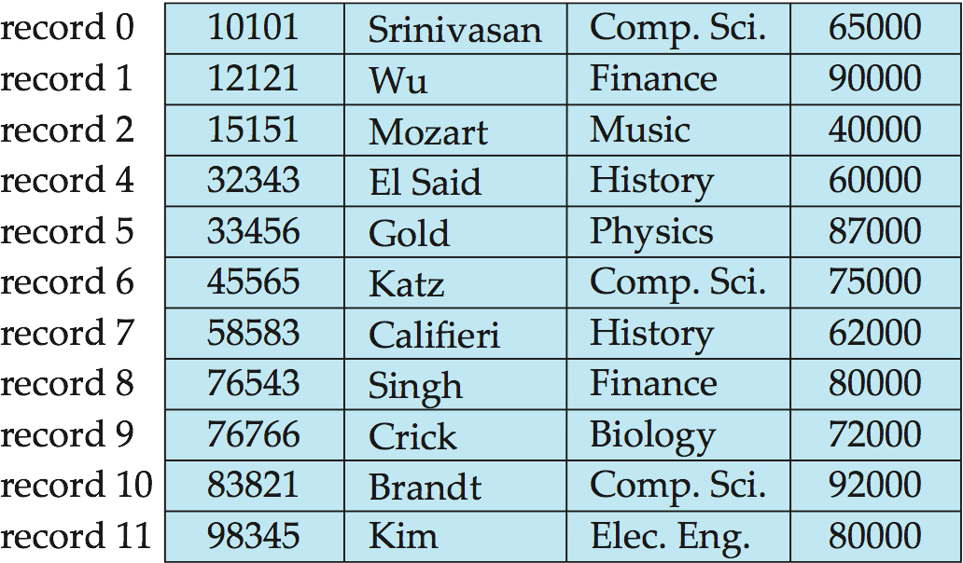
Deleting record 3 and compacting

Slide 42
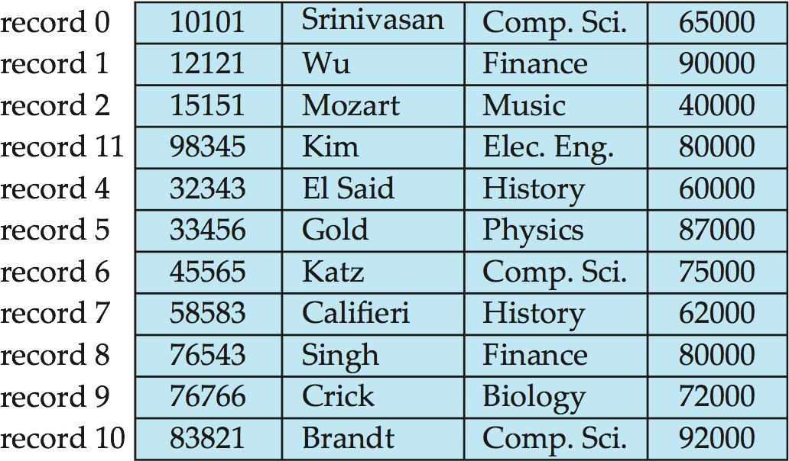
Deleting record 3 and moving last record

Slide 43
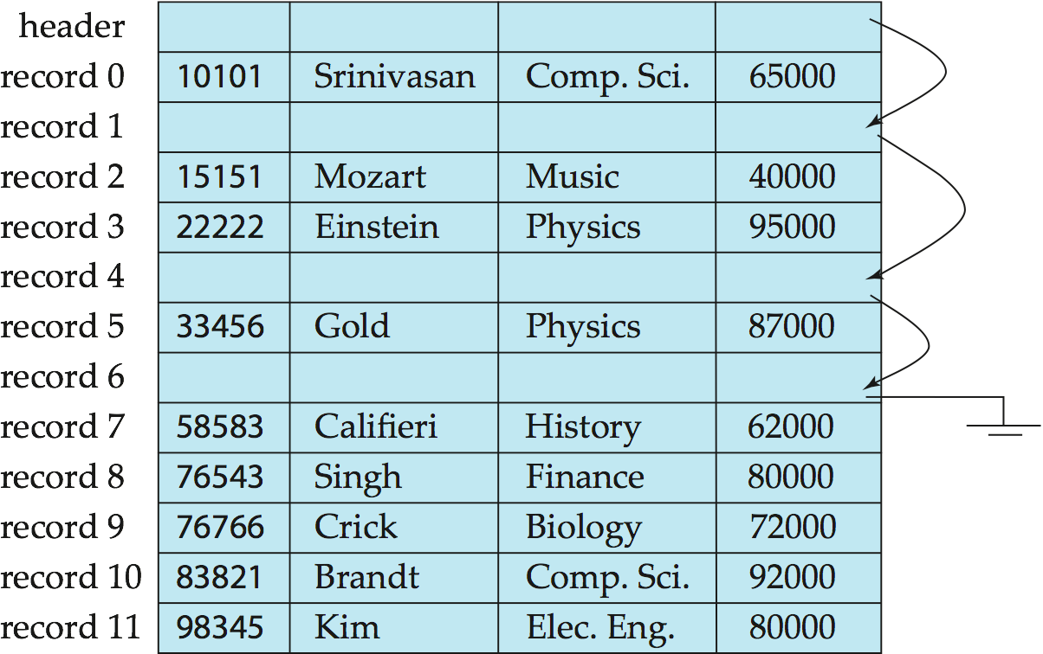
Free Lists
Store the address of the first deleted record in the file header.
Use this first record to store the address of the second deleted record, and so on
Can think of these stored addresses as pointers since they “point” to the location of a record.
More space efficient representation: reuse space for normal attributes of free records to store pointers. (No pointers stored in in-use records.)

Slide 44
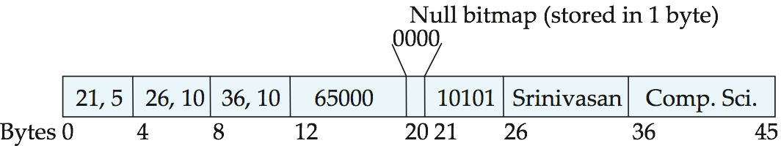
Variable-Length Records
Variable-length records arise in database systems in several ways:
Storage of multiple record types in a file.
Record types that allow variable lengths for one or more fields such as strings (varchar)
Record types that allow repeating fields (used in some older data models).
Attributes are stored in order
Variable length attributes represented by fixed size (offset, length), with actual data stored after all fixed length attributes
Null values represented by null-value bitmap

Slide 45
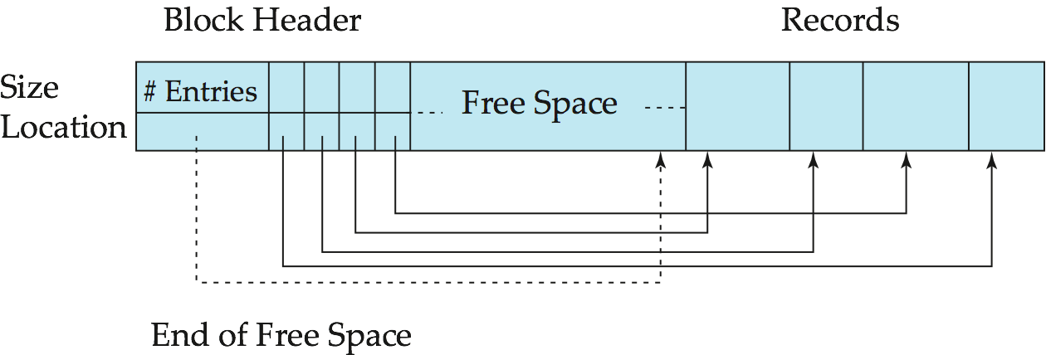
Variable-Length Records: Slotted Page Structure
Slotted page header contains:
number of record entries
end of free space in the block
location and size of each record
Records can be moved around within a page to keep them contiguous with no empty space between them; entry in the header must be updated.
Pointers should not point directly to record — instead they should point to the entry for the record in header.

Slide 46
Organization of Records in Files
Heap – a record can be placed anywhere in the file where there is space
Sequential – store records in sequential order, based on the value of the search key of each record
Hashing – a hash function computed on some attribute of each record; the result specifies in which block of the file the record should be placed
Records of each relation may be stored in a separate file. In a multitable clustering file organization records of several different relations can be stored in the same file
Motivation: store related records on the same block to minimize I/O

Slide 47
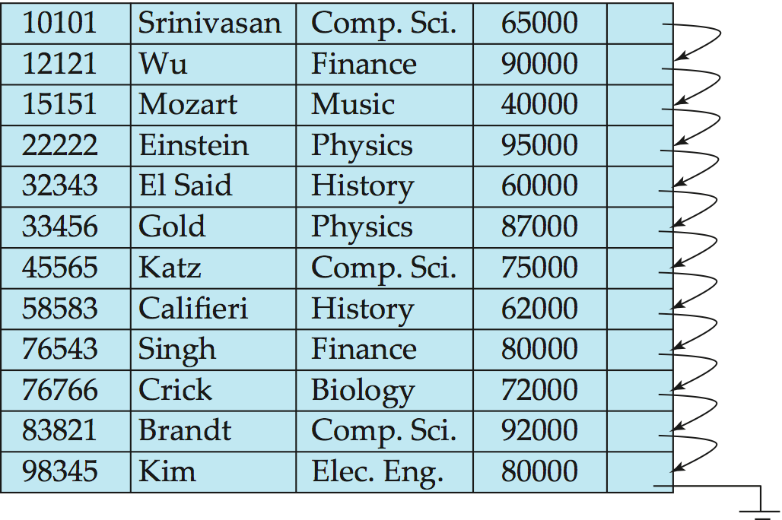
Sequential File Organization
Suitable for applications that require sequential processing of the entire file
The records in the file are ordered by a search-key

Slide 48
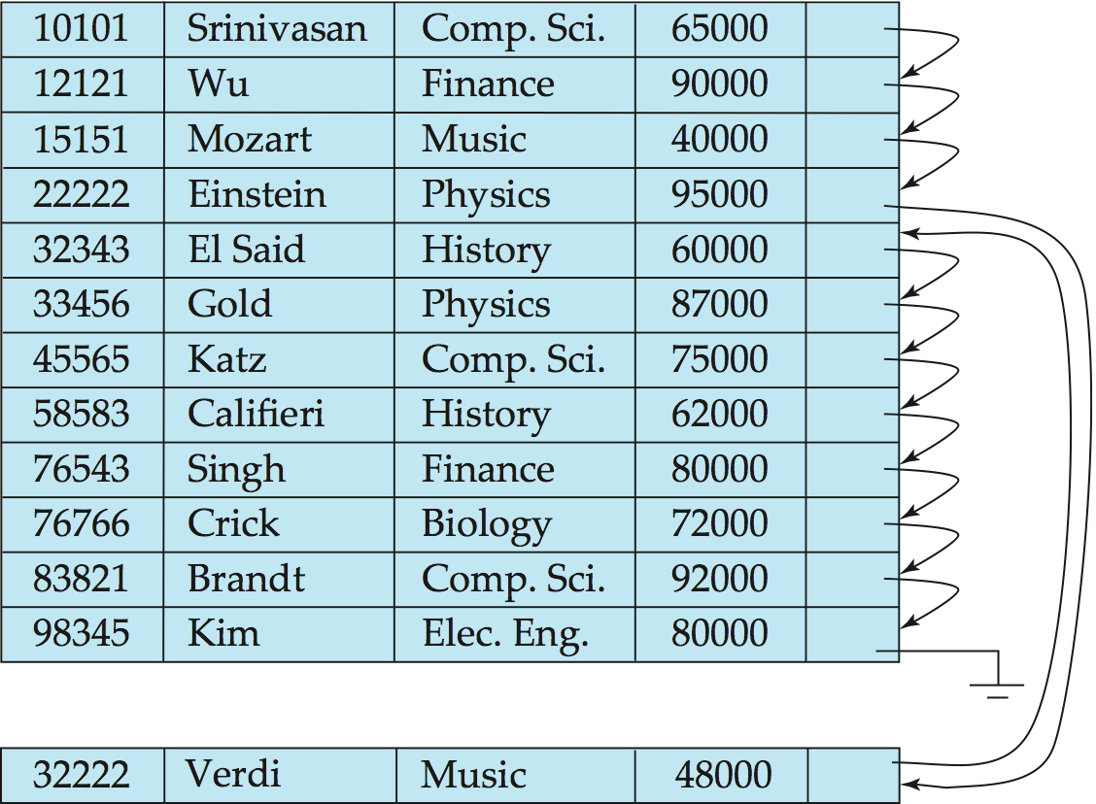
Sequential File Organization (Cont.)
Deletion – use pointer chains
Insertion –locate the position where the record is to be inserted
if there is free space insert there
if no free space, insert the record in an overflow block
In either case, pointer chain must be updated
Need to reorganize the file from time to time to restore sequential order

Slide 49
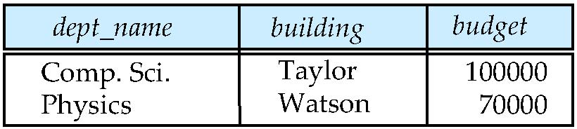
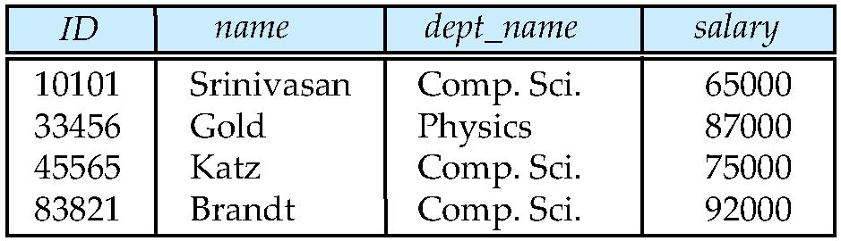
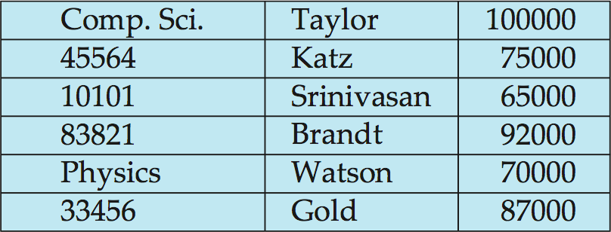
Multitable Clustering File Organization
Store several relations in one file using a multitable clustering file organization
department
instructor
multitable clustering
of department and
instructor

Slide 50
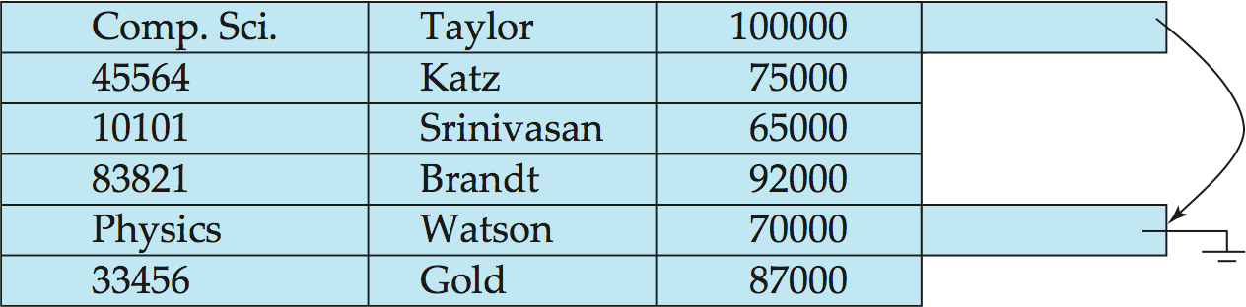
Multitable Clustering File Organization (cont.)
good for queries involving department instructor, and for queries involving one single department and its instructors
bad for queries involving only department
results in variable size records
Can add pointer chains to link records of a particular relation

Slide 51
Data Dictionary Storage
The Data dictionary (also called system catalog) stores metadata; that is, data about data, such as
Information about relations
names of relations
names, types and lengths of attributes of each relation
names and definitions of views
integrity constraints
User and accounting information, including passwords
Statistical and descriptive data
number of tuples in each relation
Physical file organization information
How relation is stored (sequential/hash/…)
Physical location of relation
Information about indices (Chapter 11)

Slide 52
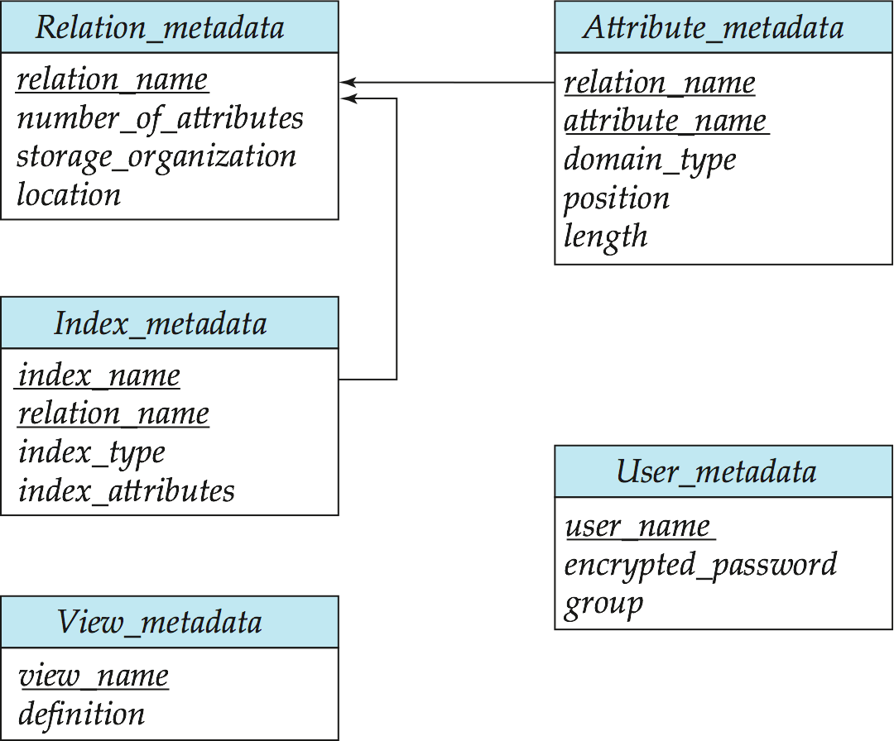
Relational Representation of System Metadata
Relational representation on disk
Specialized data structures designed for efficient access, in memory

Slide 53
Storage Access
A database file is partitioned into fixed-length storage units called blocks. Blocks are units of both storage allocation and data transfer.
Database system seeks to minimize the number of block transfers between the disk and memory. We can reduce the number of disk accesses by keeping as many blocks as possible in main memory.
Buffer – portion of main memory available to store copies of disk blocks.
Buffer manager – subsystem responsible for allocating buffer space in main memory.
Notes:
53

Slide 54
Buffer Manager
Programs call on the buffer manager when they need a block from disk.
If the block is already in the buffer, buffer manager returns the address of the block in main memory
If the block is not in the buffer, the buffer manager
Allocates space in the buffer for the block
Replacing (throwing out) some other block, if required, to make space for the new block.
Replaced block written back to disk only if it was modified since the most recent time that it was written to/fetched from the disk.
Reads the block from the disk to the buffer, and returns the address of the block in main memory to requester.
Notes:
54

Slide 55
Buffer-Replacement Policies
Most operating systems replace the block least recently used (LRU strategy)
Idea behind LRU – use past pattern of block references as a predictor of future references
Queries have well-defined access patterns (such as sequential scans), and a database system can use the information in a user’s query to predict future references
LRU can be a bad strategy for certain access patterns involving repeated scans of data
For example: when computing the join of 2 relations r and s by a nested loops for each tuple tr of r do for each tuple ts of s do if the tuples tr and ts match …
Mixed strategy with hints on replacement strategy provided by the query optimizer is preferable
Notes:
55

Slide 56
Buffer-Replacement Policies (Cont.)
Pinned block – memory block that is not allowed to be written back to disk.
Toss-immediate strategy – frees the space occupied by a block as soon as the final tuple of that block has been processed
Most recently used (MRU) strategy – system must pin the block currently being processed. After the final tuple of that block has been processed, the block is unpinned, and it becomes the most recently used block.
Buffer manager can use statistical information regarding the probability that a request will reference a particular relation
E.g., the data dictionary is frequently accessed. Heuristic: keep data-dictionary blocks in main memory buffer
Buffer managers also support forced output of blocks for the purpose of recovery (more in Chapter 16)
Notes:
56

Slide 57
End of Chapter 10

Slide 58
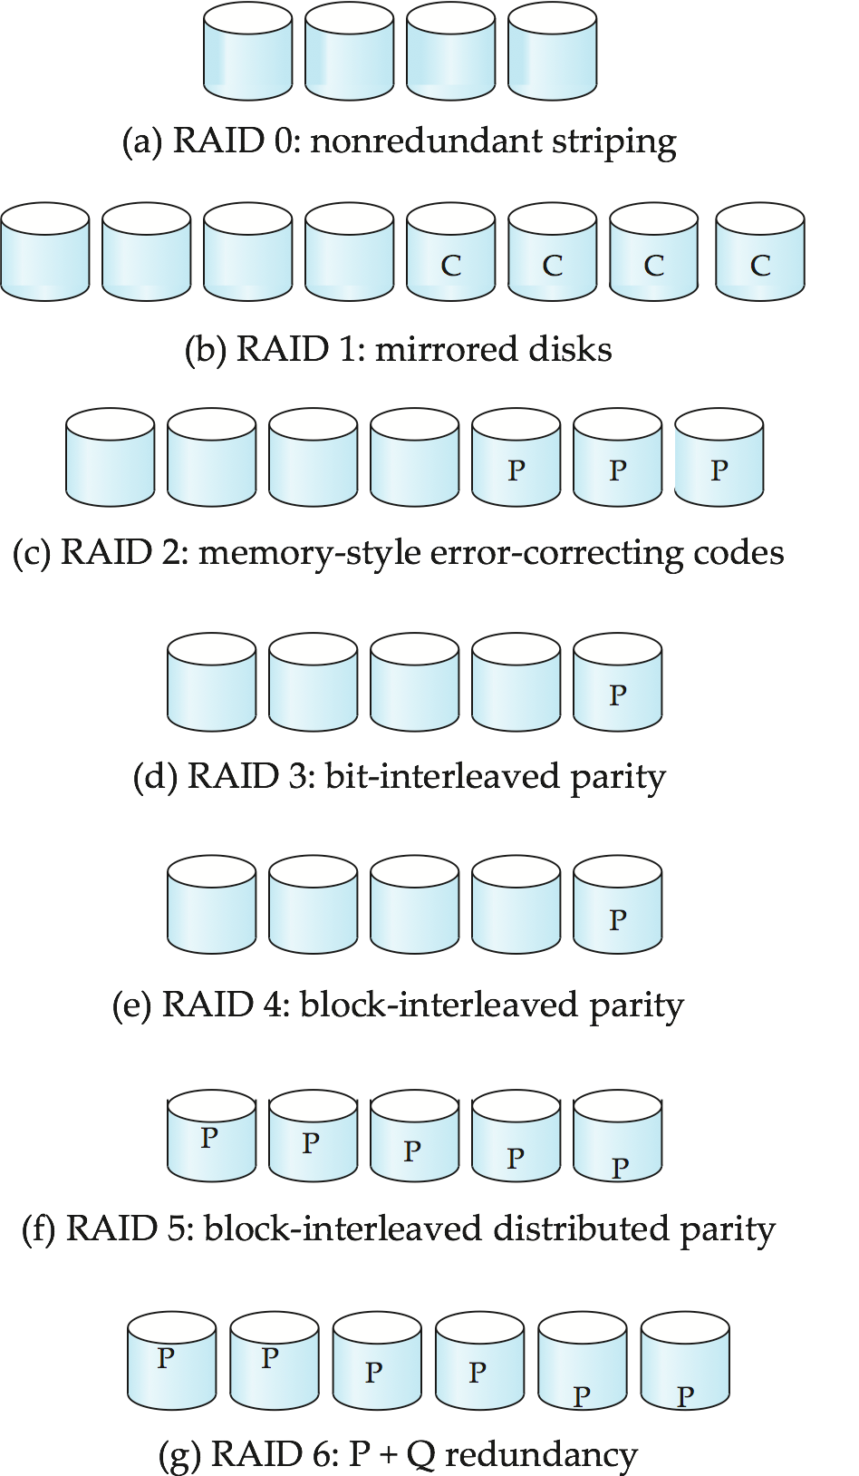
Figure 10.03

Slide 59
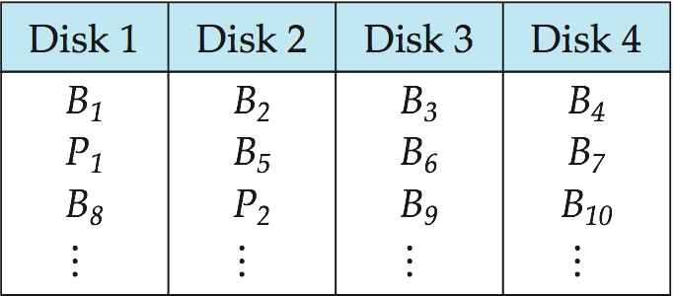
Figure 10.18

Slide 60
Figure in-10.1

Slide 61
Chapter 11: Indexing and Hashing

Slide 62
Chapter 11: Indexing and Hashing
Basic Concepts
Ordered Indices
B⁺-Tree Index Files
B-Tree Index Files
Static Hashing
Dynamic Hashing
Comparison of Ordered Indexing and Hashing
Index Definition in SQL
Multiple-Key Access

Slide 63
Basic Concepts
Indexing mechanisms used to speed up access to desired data.
E.g., author catalog in library
Search Key - attribute to set of attributes used to look up records in a file.
An index file consists of records (called index entries) of the form
Index files are typically much smaller than the original file
Two basic kinds of indices:
Ordered indices: search keys are stored in sorted order
Hash indices: search keys are distributed uniformly across “buckets” using a “hash function”.
search-key
pointer

Slide 64
Index Evaluation Metrics
Access types supported efficiently. E.g.,
records with a specified value in the attribute
or records with an attribute value falling in a specified range of values.
Access time
Insertion time
Deletion time
Space overhead

Slide 65
Ordered Indices
In an ordered index, index entries are stored sorted on the search key value. E.g., author catalog in library.
Primary index: in a sequentially ordered file, the index whose search key specifies the sequential order of the file.
Also called clustering index
The search key of a primary index is usually but not necessarily the primary key.
Secondary index: an index whose search key specifies an order different from the sequential order of the file. Also called non-clustering index.
Index-sequential file: ordered sequential file with a primary index.

Slide 66
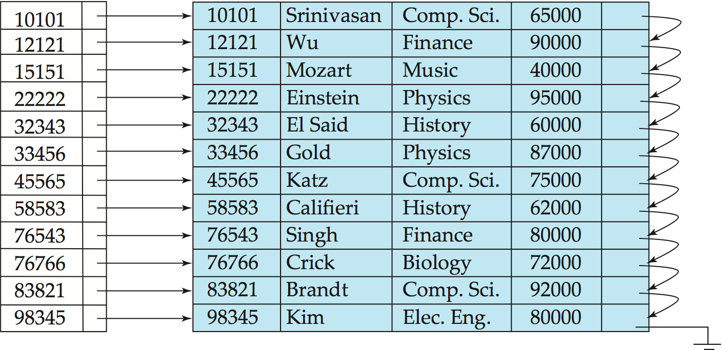
Dense Index Files
Dense index — Index record appears for every search-key value in the file.
E.g. index on ID attribute of instructor relation

Slide 67
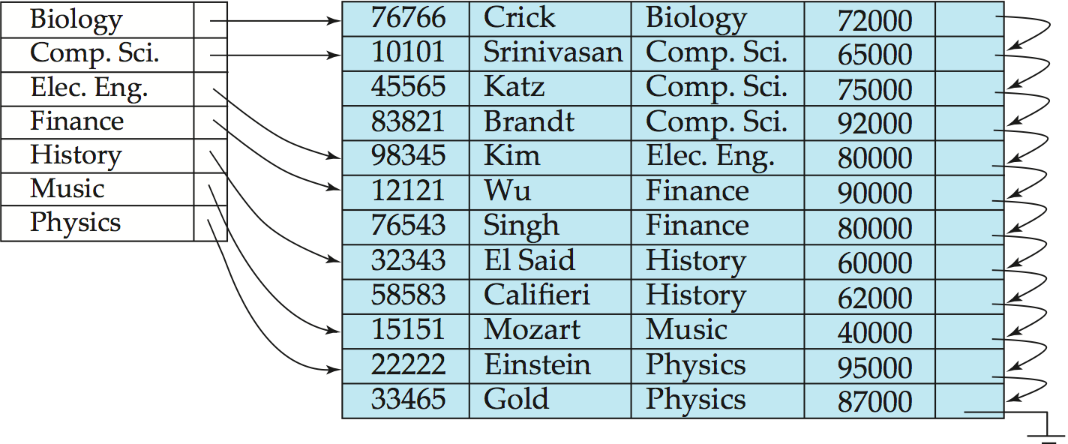
Dense Index Files (Cont.)
Dense index on dept_name, with instructor file sorted on dept_name

Slide 68
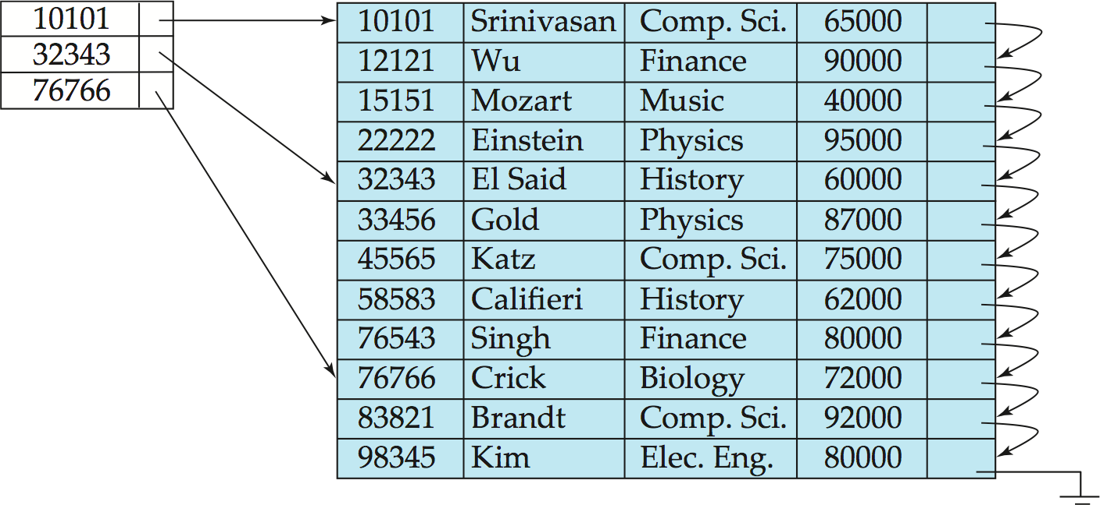
Sparse Index Files
Sparse Index: contains index records for only some search-key values.
Applicable when records are sequentially ordered on search-key
To locate a record with search-key value K we:
Find index record with largest search-key value < K
Search file sequentially starting at the record to which the index record points

Slide 69
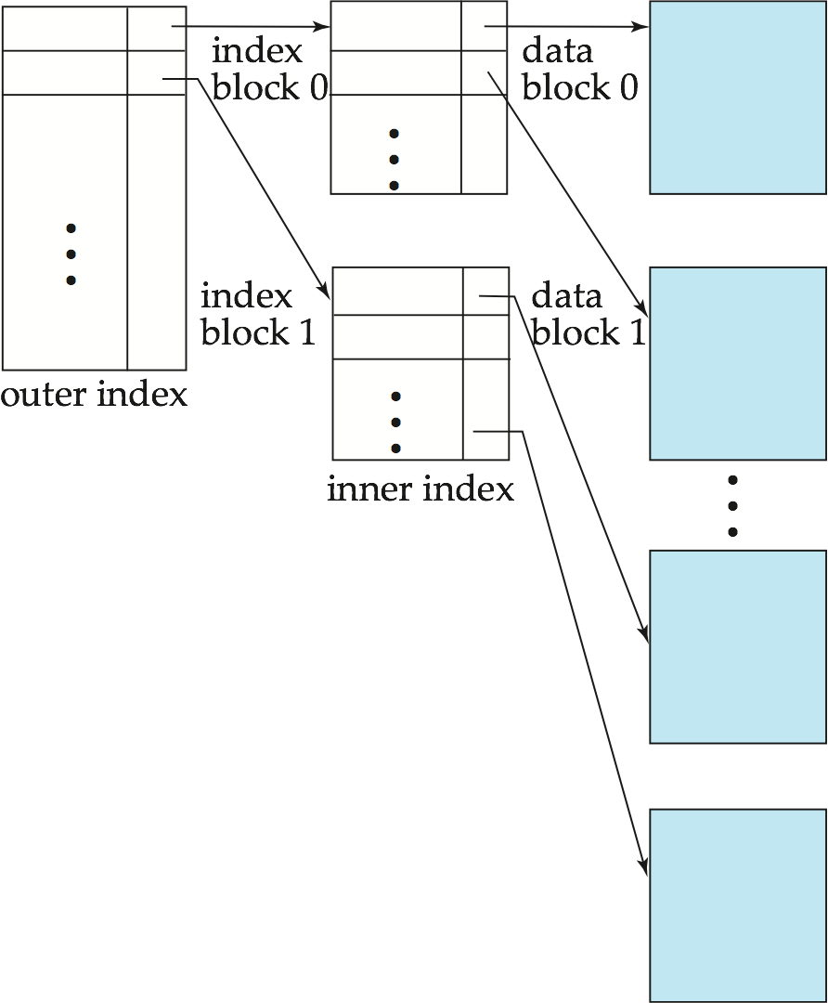
Sparse Index Files (Cont.)
Compared to dense indices:
Less space and less maintenance overhead for insertions and deletions.
Generally slower than dense index for locating records.
Good tradeoff: sparse index with an index entry for every block in file, corresponding to least search-key value in the block.

Slide 70
Secondary Indices Example
Secondary index on salary field of instructor
Index record points to a bucket that contains pointers to all the actual records with that particular search-key value.
Secondary indices have to be dense
Notes:
70

Slide 71
Primary and Secondary Indices
Indices offer substantial benefits when searching for records.
BUT: Updating indices imposes overhead on database modification --when a file is modified, every index on the file must be updated,
Sequential scan using primary index is efficient, but a sequential scan using a secondary index is expensive
Each record access may fetch a new block from disk
Block fetch requires about 5 to 10 milliseconds, versus about 100 nanoseconds for memory access
Notes:
71

Slide 72
Multilevel Index
If primary index does not fit in memory, access becomes expensive.
Solution: treat primary index kept on disk as a sequential file and construct a sparse index on it.
outer index – a sparse index of primary index
inner index – the primary index file
If even outer index is too large to fit in main memory, yet another level of index can be created, and so on.
Indices at all levels must be updated on insertion or deletion from the file.

Slide 73
Multilevel Index (Cont.)

Slide 74
Index Update: Deletion
If deleted record was the only record in the file with its particular search-key value, the search-key is deleted from the index also.
Single-level index entry deletion:
Dense indices – deletion of search-key is similar to file record deletion.
Sparse indices –
if an entry for the search key exists in the index, it is deleted by replacing the entry in the index with the next search-key value in the file (in search-key order).
If the next search-key value already has an index entry, the entry is deleted instead of being replaced.

Slide 75
Index Update: Insertion
Single-level index insertion:
Perform a lookup using the search-key value appearing in the record to be inserted.
Dense indices – if the search-key value does not appear in the index, insert it.
Sparse indices – if index stores an entry for each block of the file, no change needs to be made to the index unless a new block is created.
If a new block is created, the first search-key value appearing in the new block is inserted into the index.
Multilevel insertion and deletion: algorithms are simple extensions of the single-level algorithms

Slide 76
Secondary Indices
Frequently, one wants to find all the records whose values in a certain field (which is not the search-key of the primary index) satisfy some condition.
Example 1: In the instructor relation stored sequentially by ID, we may want to find all instructors in a particular department
Example 2: as above, but where we want to find all instructors with a specified salary or with salary in a specified range of values
We can have a secondary index with an index record for each search-key value

Slide 77
B⁺-Tree Index Files
B⁺-tree indices are an alternative to indexed-sequential files.
Disadvantage of indexed-sequential files
performance degrades as file grows, since many overflow blocks get created.
Periodic reorganization of entire file is required.
Advantage of B⁺-tree index files:
automatically reorganizes itself with small, local, changes, in the face of insertions and deletions.
Reorganization of entire file is not required to maintain performance.
(Minor) disadvantage of B⁺-trees:
extra insertion and deletion overhead, space overhead.
Advantages of B⁺-trees outweigh disadvantages
B⁺-trees are used extensively

Slide 78
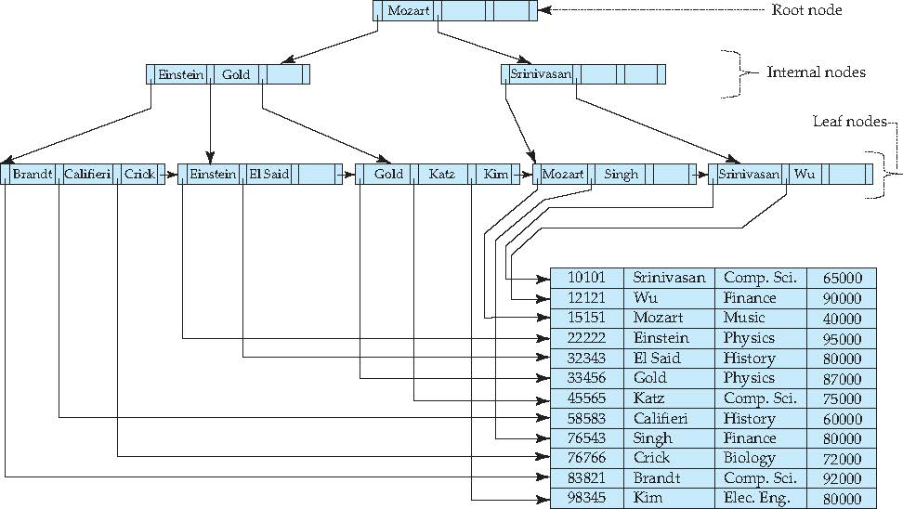
Example of B⁺-Tree

Slide 79
B⁺-Tree Index Files (Cont.)
A B⁺-tree is a rooted tree satisfying the following properties:
All paths from root to leaf are of the same length
Each node that is not a root or a leaf has between ⎡n/2⎤ and n children.
A leaf node has between ⎡(n–1)/2⎤ and n–1 values
Special cases:
If the root is not a leaf, it has at least 2 children.
If the root is a leaf (that is, there are no other nodes in the tree), it can have between 0 and (n–1) values.

Slide 80
B⁺-Tree Node Structure
Typical node
K_{i} are the search-key values
P_{i} are pointers to children (for non-leaf nodes) or pointers to records or buckets of records (for leaf nodes).
The search-keys in a node are ordered
K₁ < K₂ < K₃ < . . . < K_{n–1}
(Initially assume no duplicate keys, address duplicates later)

Slide 81
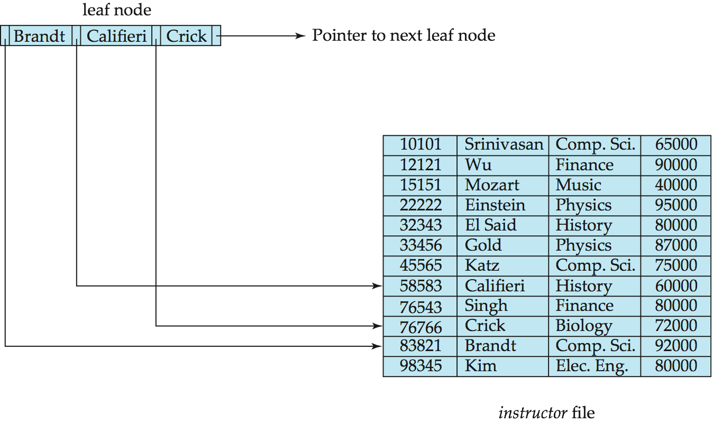
Leaf Nodes in B⁺-Trees
Properties of a leaf node:
For i = 1, 2, . . ., n–1, pointer P_{i} points to a file record with search-key value K_{i},
If L_{i}, L_{j} are leaf nodes and i < j, L_{i}’s search-key values are less than or equal to L_{j}’s search-key values
P_{n} points to next leaf node in search-key order

Slide 82
Non-Leaf Nodes in B⁺-Trees
Non leaf nodes form a multi-level sparse index on the leaf nodes. For a non-leaf node with m pointers:
All the search-keys in the subtree to which P₁ points are less than K₁
For 2 ≤ i ≤ n – 1, all the search-keys in the subtree to which P_{i} points have values greater than or equal to K_{i–1} and less than K_{i}
All the search-keys in the subtree to which P_{n} points have values greater than or equal to K_{n–1}

Slide 83
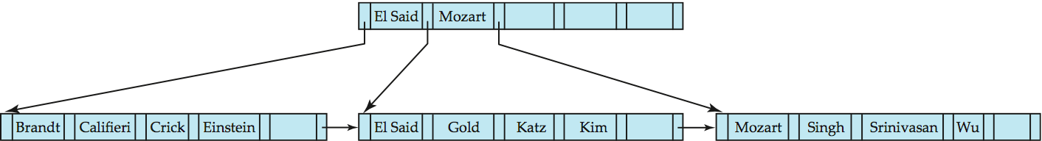
Example of B⁺-tree
B⁺-tree for instructor file (n = 6)
Leaf nodes must have between 3 and 5 values (⎡(n–1)/2⎤ and n –1, with n = 6).
Non-leaf nodes other than root must have between 3 and 6 children (⎡(n/2⎤ and n with n =6).
Root must have at least 2 children.

Slide 84
Observations about B⁺-trees
Since the inter-node connections are done by pointers, “logically” close blocks need not be “physically” close.
The non-leaf levels of the B⁺-tree form a hierarchy of sparse indices.
The B⁺-tree contains a relatively small number of levels
Level below root has at least 2* ⎡n/2⎤ values
Next level has at least 2* ⎡n/2⎤ * ⎡n/2⎤ values
.. etc.
If there are K search-key values in the file, the tree height is no more than ⎡ log_{⎡n/2⎤}(K)⎤
thus searches can be conducted efficiently.
Insertions and deletions to the main file can be handled efficiently, as the index can be restructured in logarithmic time (as we shall see).

Slide 85
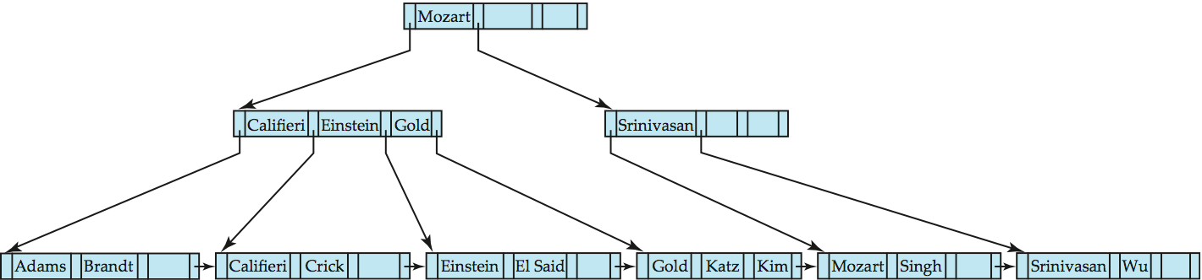
Queries on B⁺-Trees
Find record with search-key value V.
C=root
While C is not a leaf node {
Let i be least value s.t. V ≤ K_{i}.
If no such exists, set C = last non-null pointer in C
Else { if (V= K_{i} ) Set C = P_{i +1} else set C = P_{i}}
}
Let i be least value s.t. K_{i} = V
If there is such a value i, follow pointer P_{i} to the desired record.
Else no record with search-key value k exists.

Slide 86
Handling Duplicates
With duplicate search keys
In both leaf and internal nodes,
we cannot guarantee that K₁ < K₂ < K₃ < . . . < K_{n–1}
but can guarantee K₁ ≤ K₂ ≤ K₃ ≤ . . . ≤ K_{n–1}
Search-keys in the subtree to which P_{i} points
are ≤ K_{i,}, but not necessarily < K_{i,}
To see why, suppose same search key value V is present in two leaf node L_{i} and L_{i+1}. Then in parent node K_{i} must be equal to V

Slide 87
Handling Duplicates
We modify find procedure as follows
traverse P_{i} even if V = K_{i}
As soon as we reach a leaf node C check if C has only search key values less than V
if so set C = right sibling of C before checking whether C contains V
Procedure printAll
uses modified find procedure to find first occurrence of V
Traverse through consecutive leaves to find all occurrences of V
** Errata note: modified find procedure missing in first printing of 6th edition

Slide 88
Queries on B⁺⁻Trees (Cont.)
If there are K search-key values in the file, the height of the tree is no more than ⎡log_{⎡n/2⎤}(K)⎤.
A node is generally the same size as a disk block, typically 4 kilobytes
and n is typically around 100 (40 bytes per index entry).
With 1 million search key values and n = 100
at most log₅₀(1,000,000) = 4 nodes are accessed in a lookup.
Contrast this with a balanced binary tree with 1 million search key values — around 20 nodes are accessed in a lookup
above difference is significant since every node access may need a disk I/O, costing around 20 milliseconds

Slide 89
Updates on B⁺-Trees: Insertion
Find the leaf node in which the search-key value would appear
If the search-key value is already present in the leaf node
Add record to the file
If necessary add a pointer to the bucket.
If the search-key value is not present, then
add the record to the main file (and create a bucket if necessary)
If there is room in the leaf node, insert (key-value, pointer) pair in the leaf node
Otherwise, split the node (along with the new (key-value, pointer) entry) as discussed in the next slide.

Slide 90
Updates on B⁺-Trees: Insertion (Cont.)
Splitting a leaf node:
take the n (search-key value, pointer) pairs (including the one being inserted) in sorted order. Place the first ⎡n/2⎤ in the original node, and the rest in a new node.
let the new node be p, and let k be the least key value in p. Insert (k,p) in the parent of the node being split.
If the parent is full, split it and propagate the split further up.
Splitting of nodes proceeds upwards till a node that is not full is found.
In the worst case the root node may be split increasing the height of the tree by 1.
Result of splitting node containing Brandt, Califieri and Crick on inserting Adams
Next step: insert entry with (Califieri,pointer-to-new-node) into parent

Slide 91
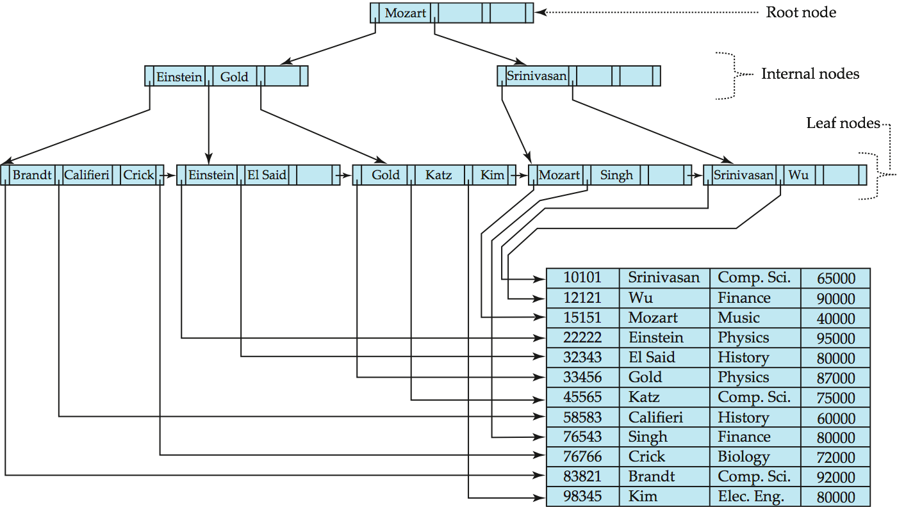
B⁺-Tree Insertion
B⁺-Tree before and after insertion of “Adams”

Slide 92
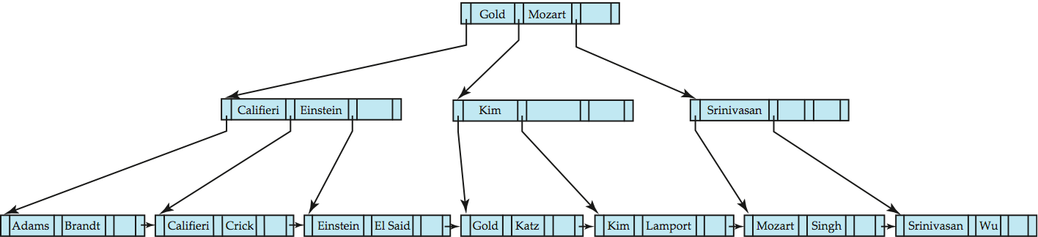
B⁺-Tree Insertion
B⁺-Tree before and after insertion of “Lamport”

Slide 93
Insertion in B⁺-Trees (Cont.)
Splitting a non-leaf node: when inserting (k,p) into an already full internal node N
Copy N to an in-memory area M with space for n+1 pointers and n keys
Insert (k,p) into M
Copy P₁,K₁, …, K _{⎡n/2⎤-1},P _{⎡n/2⎤} from M back into node N
Copy P_{⎡n/2⎤+1},K _{⎡n/2⎤+1},…,K_{n},P_{n+1} from M into newly allocated node N’
Insert (K _{⎡n/2⎤},N’) into parent N
Read pseudocode in book!
Califieri
Adams Brandt Califieri Crick
Adams Brandt
Crick

Slide 94
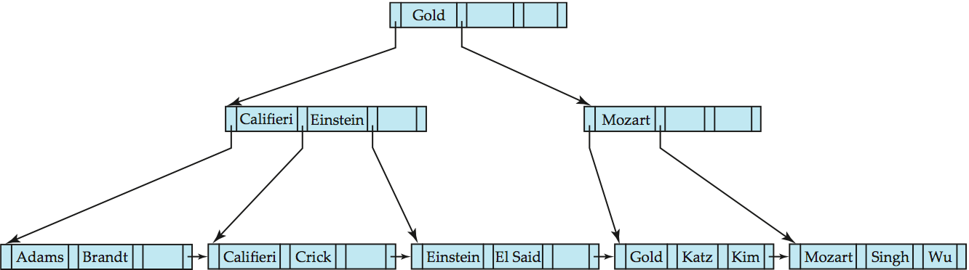
Examples of B⁺-Tree Deletion
Before and after deleting “Srinivasan”
Deleting “Srinivasan” causes merging of under-full leaves

Slide 95
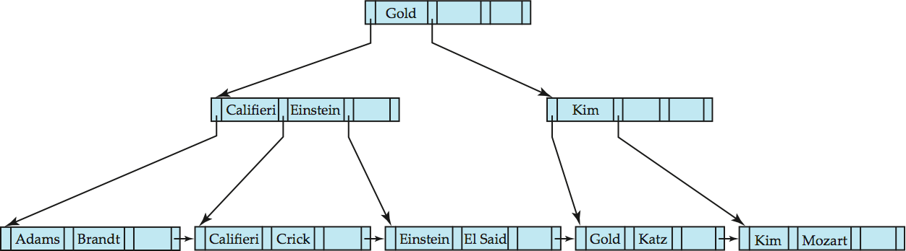
Examples of B⁺-Tree Deletion (Cont.)
Deletion of “Singh” and “Wu” from result of previous example
Leaf containing Singh and Wu became underfull, and borrowed a value Kim from its left sibling
Search-key value in the parent changes as a result

Slide 96
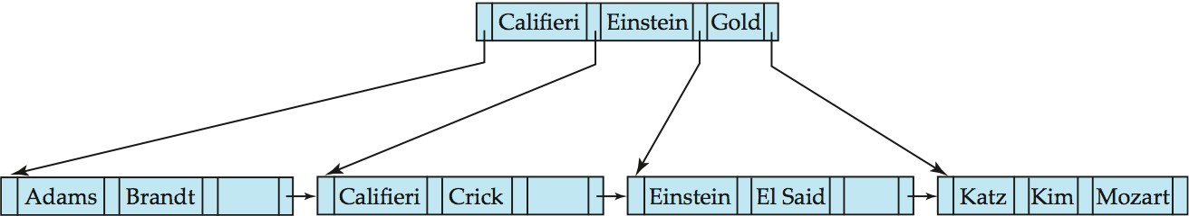
Example of B⁺-tree Deletion (Cont.)
Before and after deletion of “Gold” from earlier example
Node with Gold and Katz became underfull, and was merged with its sibling
Parent node becomes underfull, and is merged with its sibling
Value separating two nodes (at the parent) is pulled down when merging
Root node then has only one child, and is deleted

Slide 97
Updates on B⁺-Trees: Deletion
Find the record to be deleted, and remove it from the main file and from the bucket (if present)
Remove (search-key value, pointer) from the leaf node if there is no bucket or if the bucket has become empty
If the node has too few entries due to the removal, and the entries in the node and a sibling fit into a single node, then merge siblings:
Insert all the search-key values in the two nodes into a single node (the one on the left), and delete the other node.
Delete the pair (K_{i–1}, P_{i}), where P_{i} is the pointer to the deleted node, from its parent, recursively using the above procedure.

Slide 98
Updates on B⁺-Trees: Deletion
Otherwise, if the node has too few entries due to the removal, but the entries in the node and a sibling do not fit into a single node, then redistribute pointers:
Redistribute the pointers between the node and a sibling such that both have more than the minimum number of entries.
Update the corresponding search-key value in the parent of the node.
The node deletions may cascade upwards till a node which has ⎡n/2⎤ or more pointers is found.
If the root node has only one pointer after deletion, it is deleted and the sole child becomes the root.

Slide 99
Non-Unique Search Keys
Alternatives to scheme described earlier
Buckets on separate block (bad idea)
List of tuple pointers with each key
Extra code to handle long lists
Deletion of a tuple can be expensive if there are many duplicates on search key (why?)
Low space overhead, no extra cost for queries
Make search key unique by adding a record-identifier
Extra storage overhead for keys
Simpler code for insertion/deletion
Widely used
Notes:
99

Slide 100
B⁺-Tree File Organization
Index file degradation problem is solved by using B⁺-Tree indices.
Data file degradation problem is solved by using B⁺-Tree File Organization.
The leaf nodes in a B⁺-tree file organization store records, instead of pointers.
Leaf nodes are still required to be half full
Since records are larger than pointers, the maximum number of records that can be stored in a leaf node is less than the number of pointers in a nonleaf node.
Insertion and deletion are handled in the same way as insertion and deletion of entries in a B⁺-tree index.

Slide 101
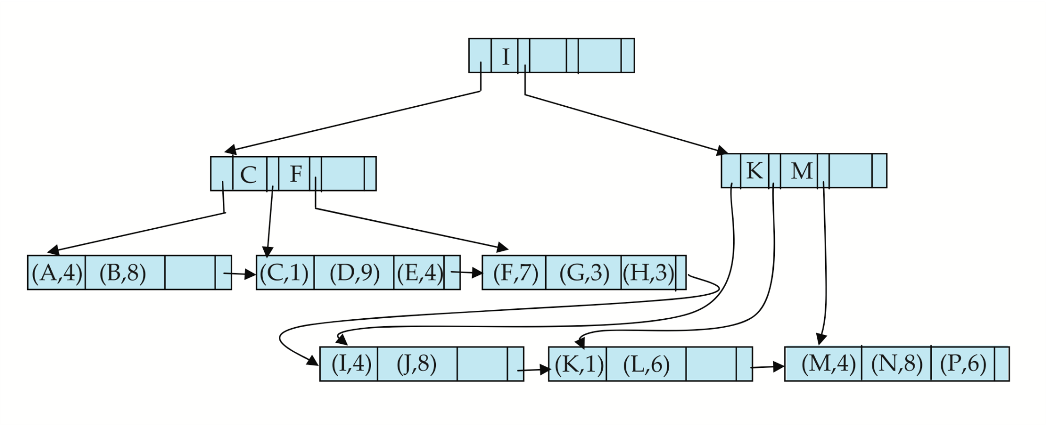
B⁺-Tree File Organization (Cont.)
Example of B⁺-tree File Organization
Good space utilization important since records use more space than pointers.
To improve space utilization, involve more sibling nodes in redistribution during splits and merges
Involving 2 siblings in redistribution (to avoid split / merge where possible) results in each node having at least entries

Slide 102
Other Issues in Indexing
Record relocation and secondary indices
If a record moves, all secondary indices that store record pointers have to be updated
Node splits in B⁺-tree file organizations become very expensive
Solution: use primary-index search key instead of record pointer in secondary index
Extra traversal of primary index to locate record
Higher cost for queries, but node splits are cheap
Add record-id if primary-index search key is non-unique
Notes:
102

Slide 103
Indexing Strings
Variable length strings as keys
Variable fanout
Use space utilization as criterion for splitting, not number of pointers
Prefix compression
Key values at internal nodes can be prefixes of full key
Keep enough characters to distinguish entries in the subtrees separated by the key value
E.g. “Silas” and “Silberschatz” can be separated by “Silb”
Keys in leaf node can be compressed by sharing common prefixes

Slide 104
Bulk Loading and Bottom-Up Build
Inserting entries one-at-a-time into a B⁺-tree requires ≥ 1 IO per entry
assuming leaf level does not fit in memory
can be very inefficient for loading a large number of entries at a time (bulk loading)
Efficient alternative 1:
sort entries first (using efficient external-memory sort algorithms discussed later in Section 12.4)
insert in sorted order
insertion will go to existing page (or cause a split)
much improved IO performance, but most leaf nodes half full
Efficient alternative 2: Bottom-up B⁺-tree construction
As before sort entries
And then create tree layer-by-layer, starting with leaf level
details as an exercise
Implemented as part of bulk-load utility by most database systems

Slide 105
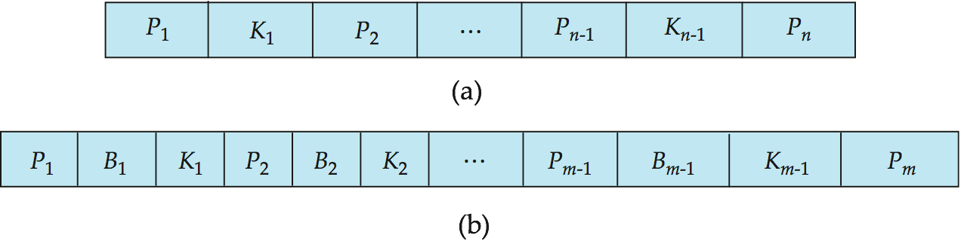
B-Tree Index Files
Similar to B+-tree, but B-tree allows search-key values to appear only once; eliminates redundant storage of search keys.
Search keys in nonleaf nodes appear nowhere else in the B-tree; an additional pointer field for each search key in a nonleaf node must be included.
Generalized B-tree leaf node
Nonleaf node – pointers Bi are the bucket or file record pointers.

Slide 106
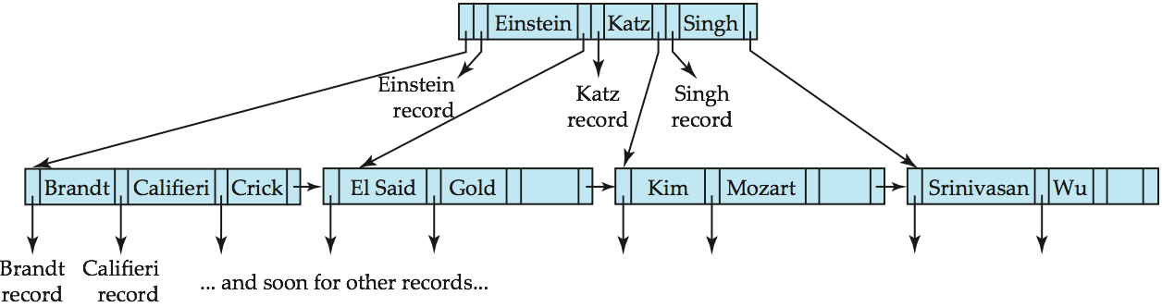
B-Tree Index File Example
B-tree (above) and B+-tree (below) on same data

Slide 107
B-Tree Index Files (Cont.)
Advantages of B-Tree indices:
May use less tree nodes than a corresponding B⁺-Tree.
Sometimes possible to find search-key value before reaching leaf node.
Disadvantages of B-Tree indices:
Only small fraction of all search-key values are found early
Non-leaf nodes are larger, so fan-out is reduced. Thus, B-Trees typically have greater depth than corresponding B⁺-Tree
Insertion and deletion more complicated than in B⁺-Trees
Implementation is harder than B⁺-Trees.
Typically, advantages of B-Trees do not out weigh disadvantages.

Slide 108
Multiple-Key Access
Use multiple indices for certain types of queries.
Example:
select ID
from instructor
where dept_name = “Finance” and salary = 80000
Possible strategies for processing query using indices on single attributes:
1. Use index on dept_name to find instructors with department name Finance; test salary = 80000
2. Use index on salary to find instructors with a salary of $80000; test dept_name = “Finance”.
3. Use dept_name index to find pointers to all records pertaining to the “Finance” department. Similarly use index on salary. Take intersection of both sets of pointers obtained.

Slide 109
Indices on Multiple Keys
Composite search keys are search keys containing more than one attribute
E.g. (dept_name, salary)
Lexicographic ordering: (a₁, a₂) < (b₁, b₂) if either
a₁ < b₁, or
a₁=b₁ and a₂ < b₂

Slide 110
Indices on Multiple Attributes
Suppose we have an index on combined search-key
(dept_name, salary).
With the where clause where dept_name = “Finance” and salary = 80000 the index on (dept_name, salary) can be used to fetch only records that satisfy both conditions.
Using separate indices in less efficient — we may fetch many records (or pointers) that satisfy only one of the conditions.
Can also efficiently handle where dept_name = “Finance” and salary < 80000
But cannot efficiently handle where dept_name < “Finance” and balance = 80000
May fetch many records that satisfy the first but not the second condition

Slide 111
Other Features
Covering indices
Add extra attributes to index so (some) queries can avoid fetching the actual records
Particularly useful for secondary indices
Why?
Can store extra attributes only at leaf

Slide 112
Hashing

Slide 113
Static Hashing
A bucket is a unit of storage containing one or more records (a bucket is typically a disk block).
In a hash file organization we obtain the bucket of a record directly from its search-key value using a hash function.
Hash function h is a function from the set of all search-key values K to the set of all bucket addresses B.
Hash function is used to locate records for access, insertion as well as deletion.
Records with different search-key values may be mapped to the same bucket; thus entire bucket has to be searched sequentially to locate a record.

Slide 114
Example of Hash File Organization
Hash file organization of instructor file, using dept_name as key (See figure in next slide.)
There are 10 buckets,
The binary representation of the ith character is assumed to be the integer i.
The hash function returns the sum of the binary representations of the characters modulo 10
E.g. h(Music) = 1 h(History) = 2 h(Physics) = 3 h(Elec. Eng.) = 3

Slide 115

Example of Hash File Organization
Hash file organization of instructor file, using dept_name as key (see previous slide for details).

Slide 116
Hash Functions
Worst hash function maps all search-key values to the same bucket; this makes access time proportional to the number of search-key values in the file.
An ideal hash function is uniform, i.e., each bucket is assigned the same number of search-key values from the set of all possible values.
Ideal hash function is random, so each bucket will have the same number of records assigned to it irrespective of the actual distribution of search-key values in the file.
Typical hash functions perform computation on the internal binary representation of the search-key.
For example, for a string search-key, the binary representations of all the characters in the string could be added and the sum modulo the number of buckets could be returned. .

Slide 117
Handling of Bucket Overflows
Bucket overflow can occur because of
Insufficient buckets
Skew in distribution of records. This can occur due to two reasons:
multiple records have same search-key value
chosen hash function produces non-uniform distribution of key values
Although the probability of bucket overflow can be reduced, it cannot be eliminated; it is handled by using overflow buckets.

Slide 118
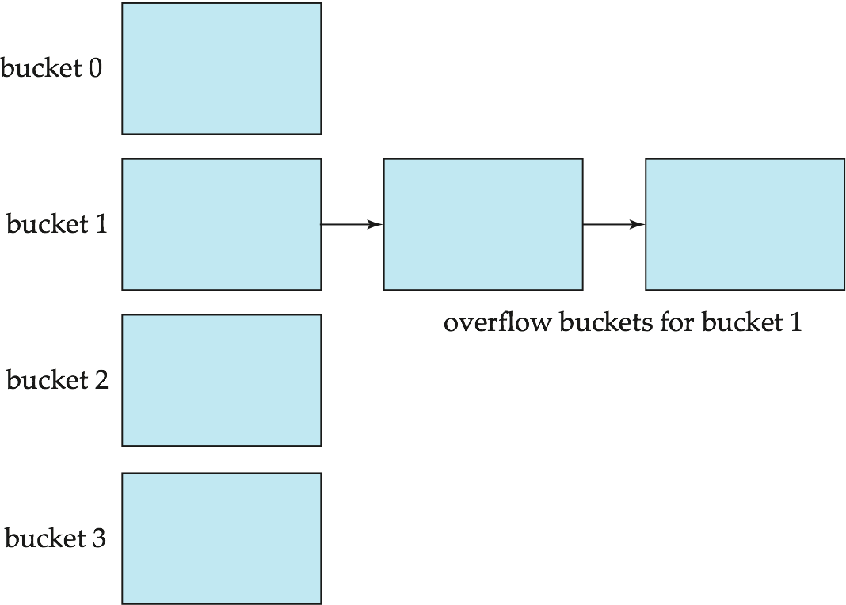
Handling of Bucket Overflows (Cont.)
Overflow chaining – the overflow buckets of a given bucket are chained together in a linked list.
Above scheme is called closed hashing.
An alternative, called open hashing, which does not use overflow buckets, is not suitable for database applications.

Slide 119
Hash Indices
Hashing can be used not only for file organization, but also for index-structure creation.
A hash index organizes the search keys, with their associated record pointers, into a hash file structure.
Strictly speaking, hash indices are always secondary indices
if the file itself is organized using hashing, a separate primary hash index on it using the same search-key is unnecessary.
However, we use the term hash index to refer to both secondary index structures and hash organized files.

Slide 120
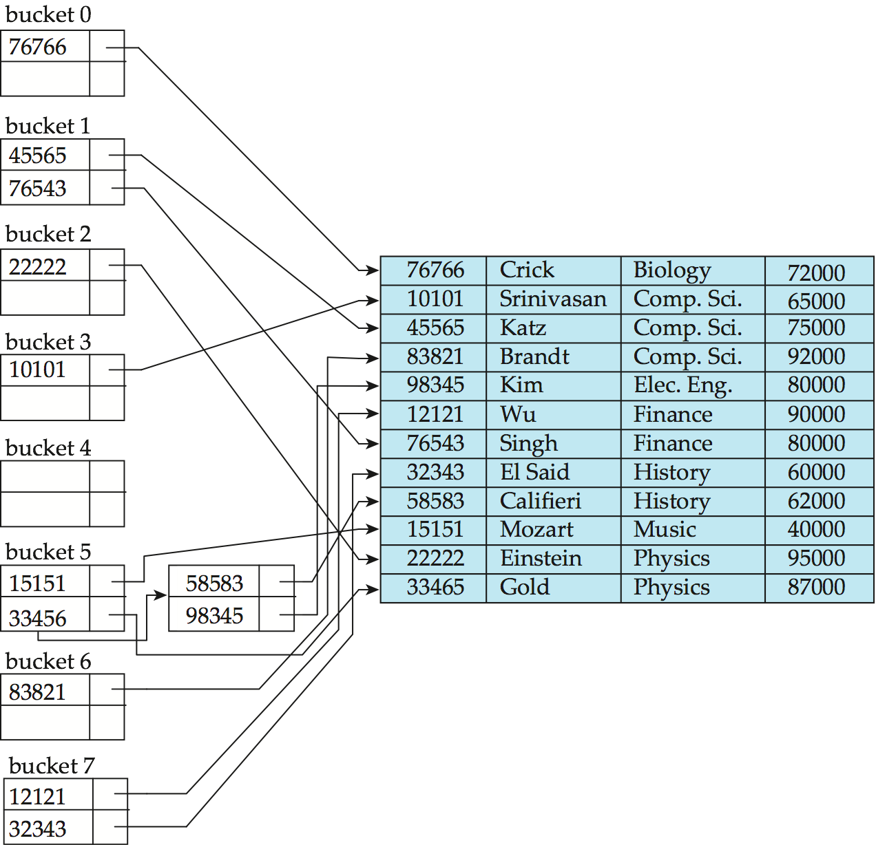
Example of Hash Index
hash index on instructor, on attribute ID

Slide 121
Deficiencies of Static Hashing
In static hashing, function h maps search-key values to a fixed set of B of bucket addresses. Databases grow or shrink with time.
If initial number of buckets is too small, and file grows, performance will degrade due to too much overflows.
If space is allocated for anticipated growth, a significant amount of space will be wasted initially (and buckets will be underfull).
If database shrinks, again space will be wasted.
One solution: periodic re-organization of the file with a new hash function
Expensive, disrupts normal operations
Better solution: allow the number of buckets to be modified dynamically.

Slide 122
Dynamic Hashing
Good for database that grows and shrinks in size
Allows the hash function to be modified dynamically
Extendable hashing – one form of dynamic hashing
Hash function generates values over a large range — typically b-bit integers, with b = 32.
At any time use only a prefix of the hash function to index into a table of bucket addresses.
Let the length of the prefix be i bits, 0 ≤ i ≤ 32.
Bucket address table size = 2^{i.} Initially i = 0
Value of i grows and shrinks as the size of the database grows and shrinks.
Multiple entries in the bucket address table may point to a bucket (why?)
Thus, actual number of buckets is < 2^{i}
The number of buckets also changes dynamically due to coalescing and splitting of buckets.

Slide 123
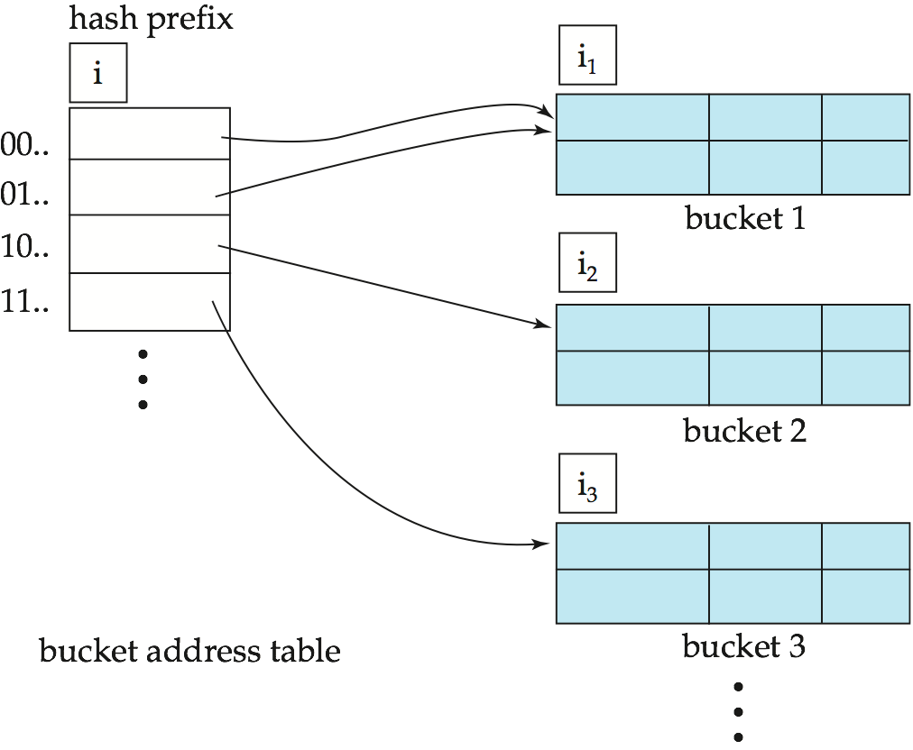
General Extendable Hash Structure
In this structure, i₂ = i₃ = i, whereas i₁ = i – 1 (see next slide for details)

Slide 124
Use of Extendable Hash Structure
Each bucket j stores a value i_{j}
All the entries that point to the same bucket have the same values on the first i_{j} bits.
To locate the bucket containing search-key K_{j}:
1. Compute h(K_{j}) = X
2. Use the first i high order bits of X as a displacement into bucket address table, and follow the pointer to appropriate bucket
To insert a record with search-key value K_{j}
follow same procedure as look-up and locate the bucket, say j.
If there is room in the bucket j insert record in the bucket.
Else the bucket must be split and insertion re-attempted (next slide.)
Overflow buckets used instead in some cases (will see shortly)

Slide 125
Insertion in Extendable Hash Structure (Cont)
To split a bucket j when inserting record with search-key value K_{j}:
If i > i_{j} (more than one pointer to bucket j)
allocate a new bucket z, and set i_{j} = i_{z} = (i_{j} + 1)
Update the second half of the bucket address table entries originally pointing to j, to point to z
remove each record in bucket j and reinsert (in j or z)
recompute new bucket for K_{j} and insert record in the bucket (further splitting is required if the bucket is still full)
If i = i_{j} (only one pointer to bucket j)
If i reaches some limit b, or too many splits have happened in this insertion, create an overflow bucket
Else
increment i and double the size of the bucket address table.
replace each entry in the table by two entries that point to the same bucket.
recompute new bucket address table entry for K_{j} Now i > i_{j} so use the first case above.

Slide 126
Deletion in Extendable Hash Structure
To delete a key value,
locate it in its bucket and remove it.
The bucket itself can be removed if it becomes empty (with appropriate updates to the bucket address table).
Coalescing of buckets can be done (can coalesce only with a “buddy” bucket having same value of i_{j} and same i_{j} –1 prefix, if it is present)
Decreasing bucket address table size is also possible
Note: decreasing bucket address table size is an expensive operation and should be done only if number of buckets becomes much smaller than the size of the table

Slide 127
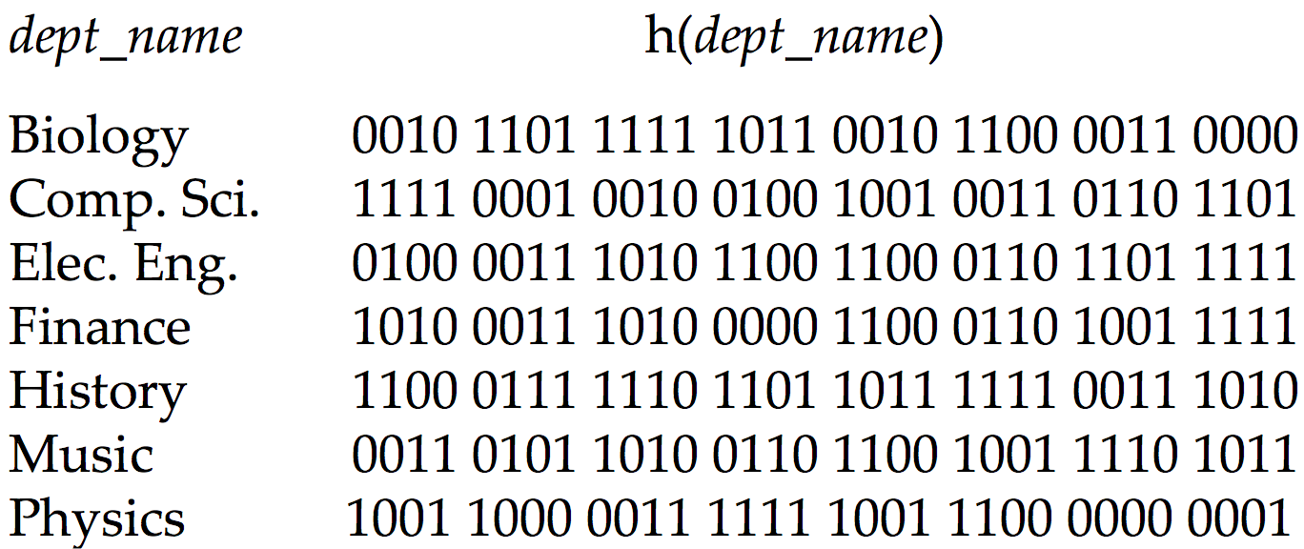
Use of Extendable Hash Structure: Example

Slide 128
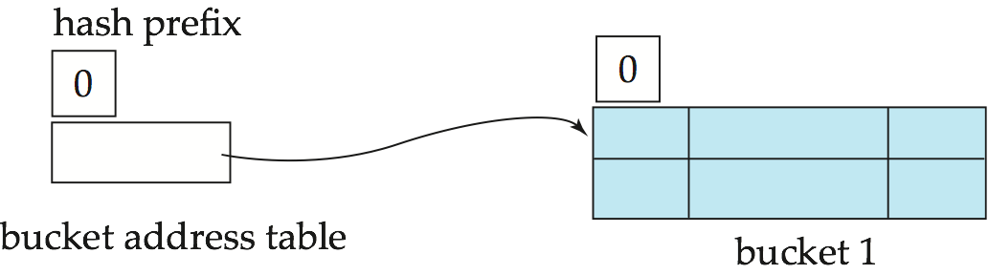
Example (Cont.)
Initial Hash structure; bucket size = 2

Slide 129
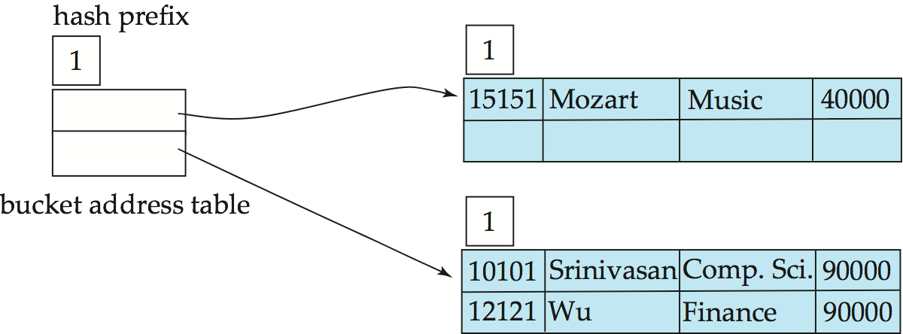
Example (Cont.)
Hash structure after insertion of “Mozart”, “Srinivasan”, and “Wu” records

Slide 130
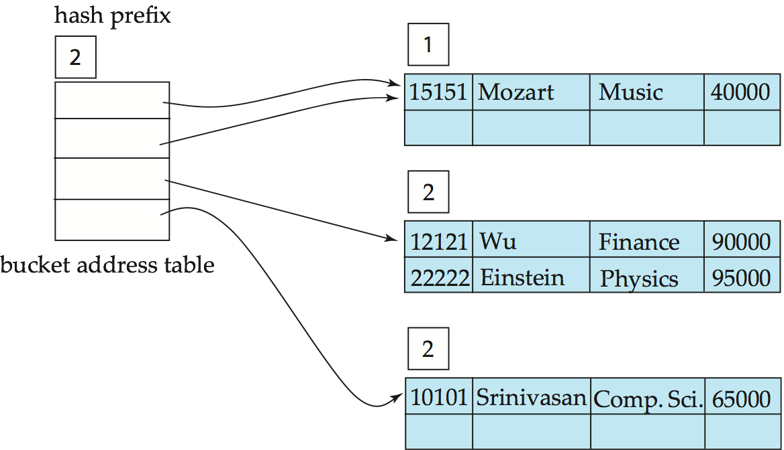
Example (Cont.)
Hash structure after insertion of Einstein record

Slide 131
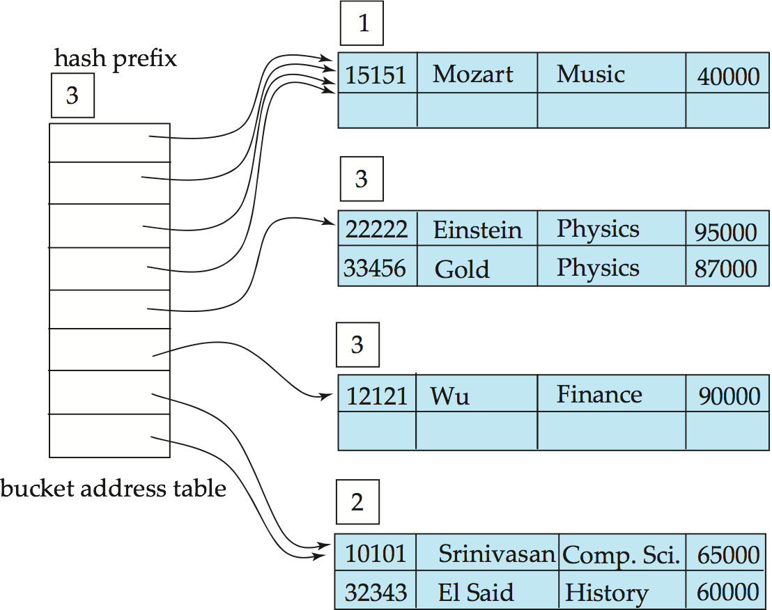
Example (Cont.)
Hash structure after insertion of Gold and El Said records

Slide 132
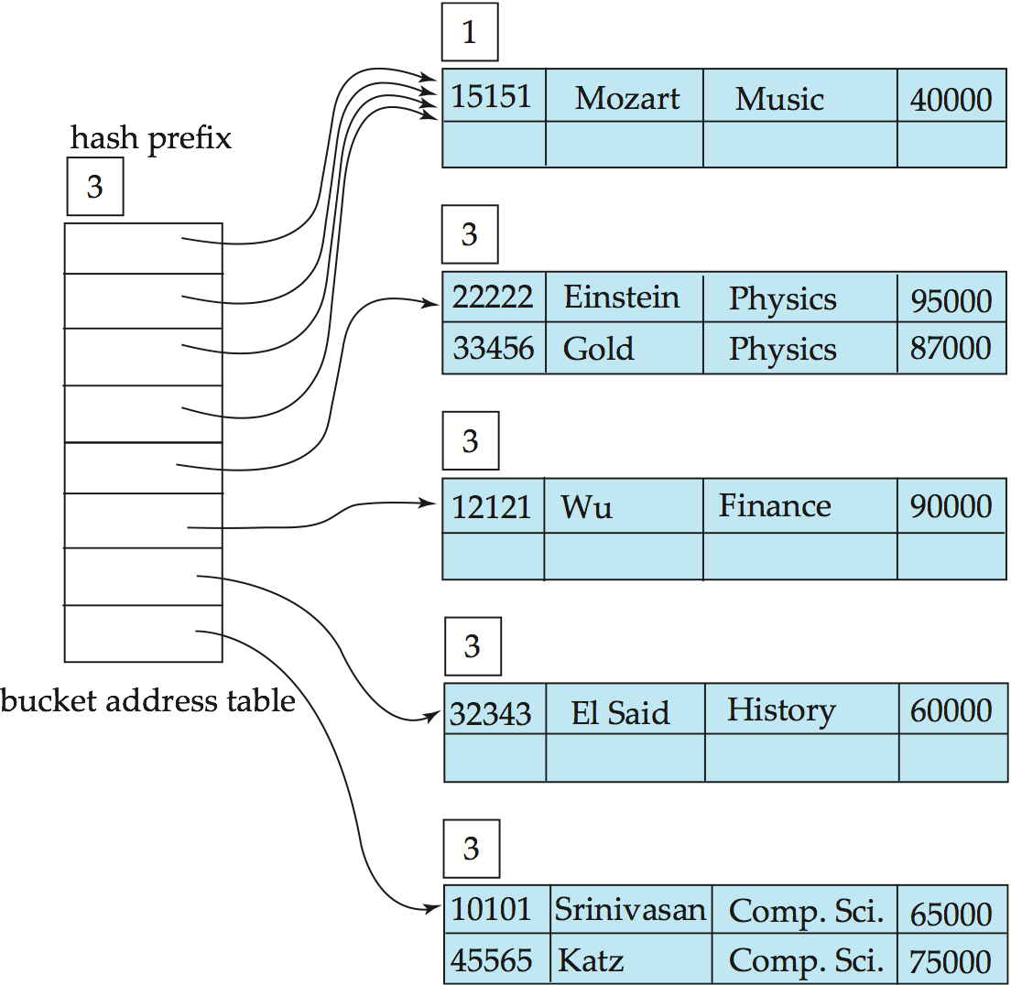
Example (Cont.)
Hash structure after insertion of Katz record

Slide 133
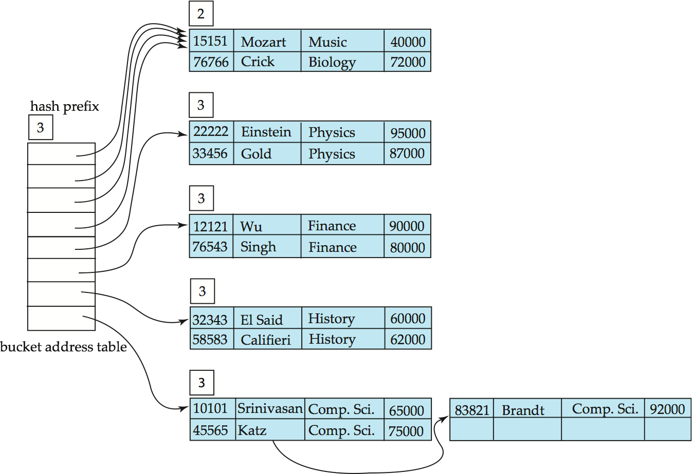
Example (Cont.)
And after insertion of
eleven records

Slide 134
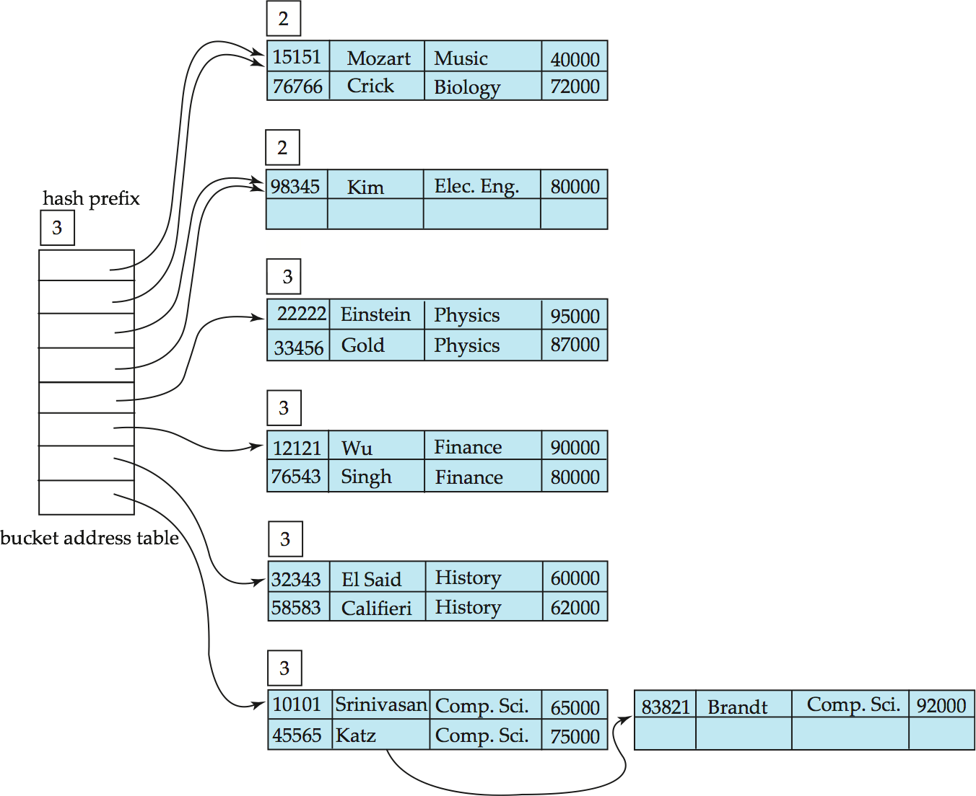
Example (Cont.)
And after insertion of
Kim record in previous
hash structure

Slide 135
Extendable Hashing vs. Other Schemes
Benefits of extendable hashing:
Hash performance does not degrade with growth of file
Minimal space overhead
Disadvantages of extendable hashing
Extra level of indirection to find desired record
Bucket address table may itself become very big (larger than memory)
Cannot allocate very large contiguous areas on disk either
Solution: B⁺-tree structure to locate desired record in bucket address table
Changing size of bucket address table is an expensive operation
Linear hashing is an alternative mechanism
Allows incremental growth of its directory (equivalent to bucket address table)
At the cost of more bucket overflows

Slide 136
Comparison of Ordered Indexing and Hashing
Cost of periodic re-organization
Relative frequency of insertions and deletions
Is it desirable to optimize average access time at the expense of worst-case access time?
Expected type of queries:
Hashing is generally better at retrieving records having a specified value of the key.
If range queries are common, ordered indices are to be preferred
In practice:
PostgreSQL supports hash indices, but discourages use due to poor performance
Oracle supports static hash organization, but not hash indices
SQLServer supports only B⁺-trees

Slide 137
Bitmap Indices
Bitmap indices are a special type of index designed for efficient querying on multiple keys
Records in a relation are assumed to be numbered sequentially from, say, 0
Given a number n it must be easy to retrieve record n
Particularly easy if records are of fixed size
Applicable on attributes that take on a relatively small number of distinct values
E.g. gender, country, state, …
E.g. income-level (income broken up into a small number of levels such as 0-9999, 10000-19999, 20000-50000, 50000- infinity)
A bitmap is simply an array of bits

Slide 138
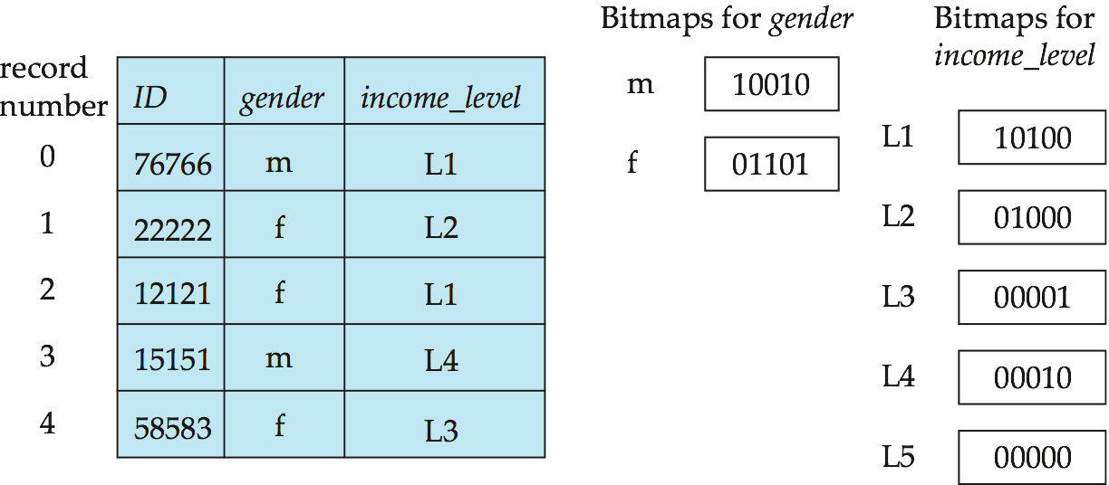
Bitmap Indices (Cont.)
In its simplest form a bitmap index on an attribute has a bitmap for each value of the attribute
Bitmap has as many bits as records
In a bitmap for value v, the bit for a record is 1 if the record has the value v for the attribute, and is 0 otherwise

Slide 139
Bitmap Indices (Cont.)
Bitmap indices are useful for queries on multiple attributes
not particularly useful for single attribute queries
Queries are answered using bitmap operations
Intersection (and)
Union (or)
Complementation (not)
Each operation takes two bitmaps of the same size and applies the operation on corresponding bits to get the result bitmap
E.g. 100110 AND 110011 = 100010
100110 OR 110011 = 110111 NOT 100110 = 011001
Males with income level L1: 10010 AND 10100 = 10000
Can then retrieve required tuples.
Counting number of matching tuples is even faster

Slide 140
Bitmap Indices (Cont.)
Bitmap indices generally very small compared with relation size
E.g. if record is 100 bytes, space for a single bitmap is 1/800 of space used by relation.
If number of distinct attribute values is 8, bitmap is only 1% of relation size
Deletion needs to be handled properly
Existence bitmap to note if there is a valid record at a record location
Needed for complementation
not(A=v): (NOT bitmap-A-v) AND ExistenceBitmap
Should keep bitmaps for all values, even null value
To correctly handle SQL null semantics for NOT(A=v):
intersect above result with (NOT bitmap-A-Null)

Slide 141
Efficient Implementation of Bitmap Operations
Bitmaps are packed into words; a single word and (a basic CPU instruction) computes and of 32 or 64 bits at once
E.g. 1-million-bit maps can be and-ed with just 31,250 instruction
Counting number of 1s can be done fast by a trick:
Use each byte to index into a precomputed array of 256 elements each storing the count of 1s in the binary representation
Can use pairs of bytes to speed up further at a higher memory cost
Add up the retrieved counts
Bitmaps can be used instead of Tuple-ID lists at leaf levels of B⁺-trees, for values that have a large number of matching records
Worthwhile if > 1/64 of the records have that value, assuming a tuple-id is 64 bits
Above technique merges benefits of bitmap and B⁺-tree indices

Slide 142
Index Definition in SQL
Create an index
create index <index-name> on <relation-name> (<attribute-list>)
E.g.: create index b-index on branch(branch_name)
Use create unique index to indirectly specify and enforce the condition that the search key is a candidate key is a candidate key.
Not really required if SQL unique integrity constraint is supported
To drop an index
drop index <index-name>
Most database systems allow specification of type of index, and clustering.

Slide 143
End of Chapter

Slide 144
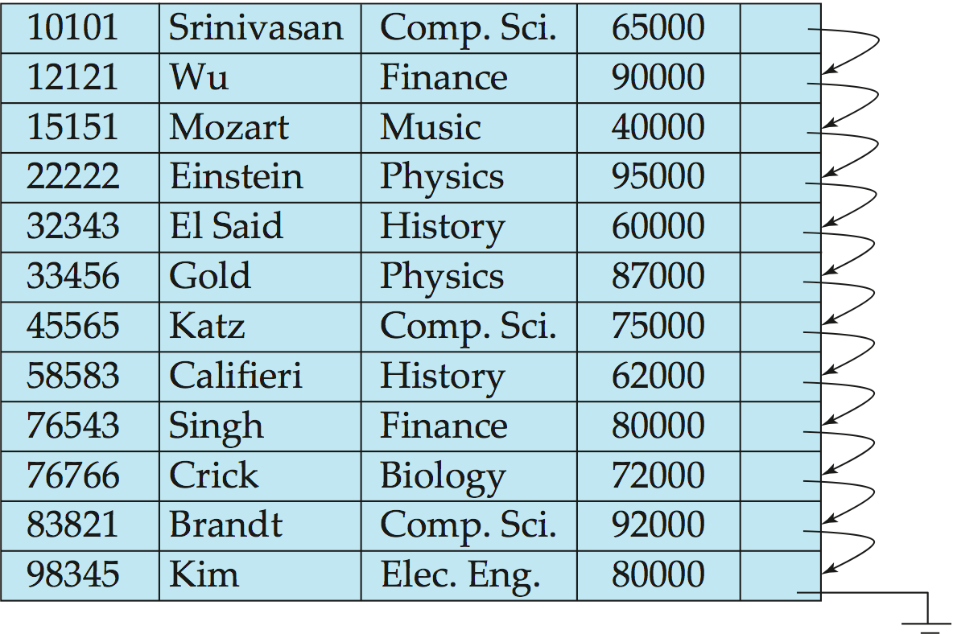
Figure 11.01

Slide 145
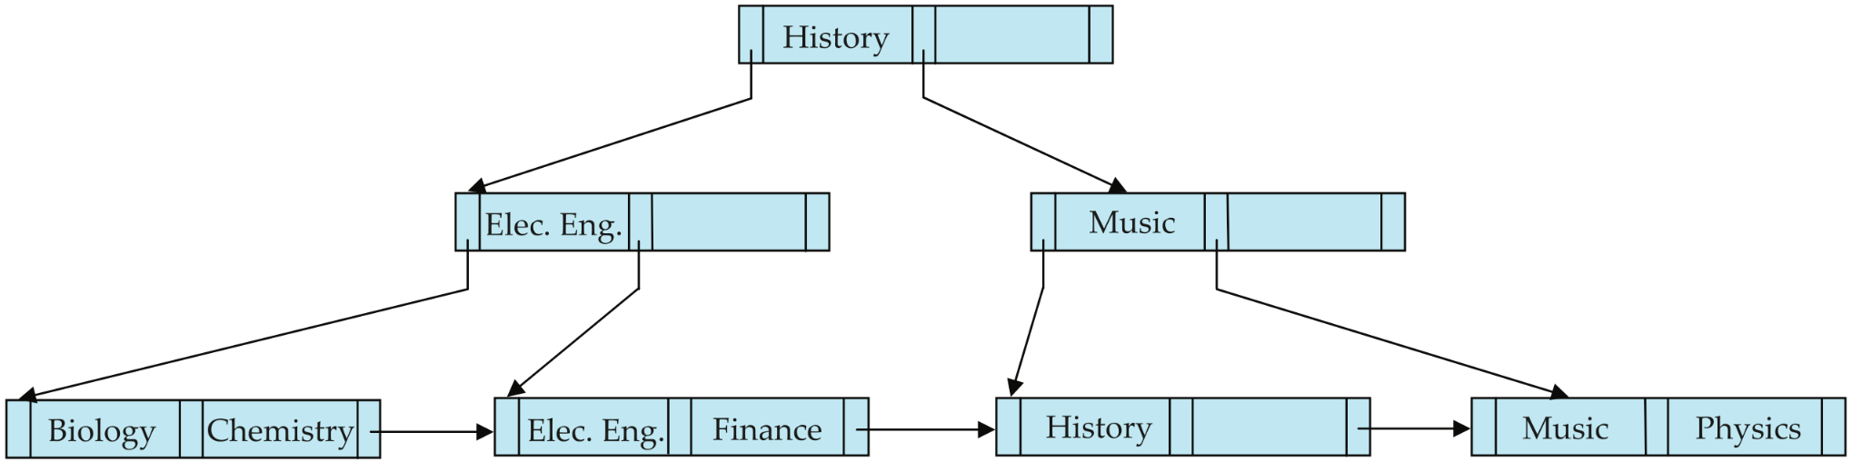
Figure 11.15

Slide 146
Partitioned Hashing
Hash values are split into segments that depend on each attribute of the search-key.
(A₁, A₂, . . . , A_{n}) for n attribute search-key
Example: n = 2, for customer, search-key being (customer-street, customer-city)
search-key value hash value (Main, Harrison) 101 111 (Main, Brooklyn) 101 001 (Park, Palo Alto) 010 010 (Spring, Brooklyn) 001 001 (Alma, Palo Alto) 110 010
To answer equality query on single attribute, need to look up multiple buckets. Similar in effect to grid files.

Slide 147
Grid Files
Structure used to speed the processing of general multiple search-key queries involving one or more comparison operators.
The grid file has a single grid array and one linear scale for each search-key attribute. The grid array has number of dimensions equal to number of search-key attributes.
Multiple cells of grid array can point to same bucket
To find the bucket for a search-key value, locate the row and column of its cell using the linear scales and follow pointer

Slide 148

Example Grid File for account

Slide 149
Queries on a Grid File
A grid file on two attributes A and B can handle queries of all following forms with reasonable efficiency
(a₁ ≤ A ≤ a₂)
(b₁ ≤ B ≤ b₂)
(a₁ ≤ A ≤ a₂ ∧ b₁ ≤ B ≤ b₂),.
E.g., to answer (a₁ ≤ A ≤ a₂ ∧ b₁ ≤ B ≤ b₂), use linear scales to find corresponding candidate grid array cells, and look up all the buckets pointed to from those cells.

Slide 150
Grid Files (Cont.)
During insertion, if a bucket becomes full, new bucket can be created if more than one cell points to it.
Idea similar to extendable hashing, but on multiple dimensions
If only one cell points to it, either an overflow bucket must be created or the grid size must be increased
Linear scales must be chosen to uniformly distribute records across cells.
Otherwise there will be too many overflow buckets.
Periodic re-organization to increase grid size will help.
But reorganization can be very expensive.
Space overhead of grid array can be high.
R-trees (Chapter 23) are an alternative

Slide 151
Chapter 12: Query Processing

Slide 152
Chapter 12: Query Processing
Overview
Measures of Query Cost
Selection Operation
Sorting
Join Operation
Other Operations
Evaluation of Expressions

Slide 153
Basic Steps in Query Processing
1. Parsing and translation
2. Optimization
3. Evaluation

Slide 154
Basic Steps in Query Processing (Cont.)
Parsing and translation
translate the query into its internal form. This is then translated into relational algebra.
Parser checks syntax, verifies relations
Evaluation
The query-execution engine takes a query-evaluation plan, executes that plan, and returns the answers to the query.

Slide 155
Basic Steps in Query Processing : Optimization
A relational algebra expression may have many equivalent expressions
E.g., σ_{salary<75000}(∏_{salary}(instructor)) is equivalent to ∏_{salary}(σ_{salary<75000}(instructor))
Each relational algebra operation can be evaluated using one of several different algorithms
Correspondingly, a relational-algebra expression can be evaluated in many ways.
Annotated expression specifying detailed evaluation strategy is called an evaluation-plan.
E.g., can use an index on salary to find instructors with salary < 75000,
or can perform complete relation scan and discard instructors with salary ≥ 75000

Slide 156
Basic Steps: Optimization (Cont.)
Query Optimization: Amongst all equivalent evaluation plans choose the one with lowest cost.
Cost is estimated using statistical information from the database catalog
e.g. number of tuples in each relation, size of tuples, etc.
In this chapter we study
How to measure query costs
Algorithms for evaluating relational algebra operations
How to combine algorithms for individual operations in order to evaluate a complete expression
In Chapter 14
We study how to optimize queries, that is, how to find an evaluation plan with lowest estimated cost

Slide 157
Measures of Query Cost
Cost is generally measured as total elapsed time for answering query
Many factors contribute to time cost
disk accesses, CPU, or even network communication
Typically disk access is the predominant cost, and is also relatively easy to estimate. Measured by taking into account
Number of seeks * average-seek-cost
Number of blocks read * average-block-read-cost
Number of blocks written * average-block-write-cost
Cost to write a block is greater than cost to read a block
data is read back after being written to ensure that the write was successful

Slide 158
Measures of Query Cost (Cont.)
For simplicity we just use the number of block transfers from disk and the number of seeks as the cost measures
t_{T} – time to transfer one block
t_{S} – time for one seek
Cost for b block transfers plus S seeks b * t_{T} + S * t_{S}
We ignore CPU costs for simplicity
Real systems do take CPU cost into account
We do not include cost to writing output to disk in our cost formulae

Slide 159
Measures of Query Cost (Cont.)
Several algorithms can reduce disk IO by using extra buffer space
Amount of real memory available to buffer depends on other concurrent queries and OS processes, known only during execution
We often use worst case estimates, assuming only the minimum amount of memory needed for the operation is available
Required data may be buffer resident already, avoiding disk I/O
But hard to take into account for cost estimation
Notes:
159

Slide 160
Selection Operation
File scan
Algorithm A1 (linear search). Scan each file block and test all records to see whether they satisfy the selection condition.
Cost estimate = b_{r} block transfers + 1 seek
b_{r} denotes number of blocks containing records from relation r
If selection is on a key attribute, can stop on finding record
cost = (b_{r} /2) block transfers + 1 seek
Linear search can be applied regardless of
selection condition or
ordering of records in the file, or
availability of indices
Note: binary search generally does not make sense since data is not stored consecutively
except when there is an index available,
and binary search requires more seeks than index search

Slide 161
Selections Using Indices
Index scan – search algorithms that use an index
selection condition must be on search-key of index.
A2 (primary index, equality on key). Retrieve a single record that satisfies the corresponding equality condition
Cost = (h_{i} + 1) * (t_{T} + t_{S})
A3 (primary index, equality on nonkey) Retrieve multiple records.
Records will be on consecutive blocks
Let b = number of blocks containing matching records
Cost = h_{i} * (t_{T} + t_{S}) + t_{S} + t_{T} * b

Slide 162
Selections Using Indices
A4 (secondary index, equality on nonkey).
Retrieve a single record if the search-key is a candidate key
Cost = (h_{i} + 1) * (t_{T} + t_{S})
Retrieve multiple records if search-key is not a candidate key
each of n matching records may be on a different block
Cost = (h_{i} + n) * (t_{T} + t_{S})
Can be very expensive!
Notes:
162

Slide 163
Selections Involving Comparisons
Can implement selections of the form σ_{A≤V} (r) or σ_{A ≥ V}(r) by using
a linear file scan,
or by using indices in the following ways:
A5 (primary index, comparison). (Relation is sorted on A)
For σ_{A ≥ V}(r) use index to find first tuple ≥ v and scan relation sequentially from there
For σ_{A≤V} (r) just scan relation sequentially till first tuple > v; do not use index
A6 (secondary index, comparison).
For σ_{A ≥ V}(r) use index to find first index entry ≥ v and scan index sequentially from there, to find pointers to records.
For σ_{A≤V} (r) just scan leaf pages of index finding pointers to records, till first entry > v
In either case, retrieve records that are pointed to
requires an I/O for each record
Linear file scan may be cheaper

Slide 164
Implementation of Complex Selections
Conjunction: σ_{θ1}∧ _{θ2}∧. . . _{θn}(r)
A7 (conjunctive selection using one index).
Select a combination of θ_{i} and algorithms A1 through A7 that results in the least cost for σ_{θi} (r).
Test other conditions on tuple after fetching it into memory buffer.
A8 (conjunctive selection using composite index).
Use appropriate composite (multiple-key) index if available.
A9 (conjunctive selection by intersection of identifiers).
Requires indices with record pointers.
Use corresponding index for each condition, and take intersection of all the obtained sets of record pointers.
Then fetch records from file
If some conditions do not have appropriate indices, apply test in memory.

Slide 165
Algorithms for Complex Selections
Disjunction:σ_{θ1}∨ _{θ2} ∨. . . _{θn} (r).
A10 (disjunctive selection by union of identifiers).
Applicable if all conditions have available indices.
Otherwise use linear scan.
Use corresponding index for each condition, and take union of all the obtained sets of record pointers.
Then fetch records from file
Negation: σ_{¬θ}(r)
Use linear scan on file
If very few records satisfy ¬θ, and an index is applicable to θ
Find satisfying records using index and fetch from file

Slide 166
Sorting
We may build an index on the relation, and then use the index to read the relation in sorted order. May lead to one disk block access for each tuple.
For relations that fit in memory, techniques like quicksort can be used. For relations that don’t fit in memory, external sort-merge is a good choice.

Slide 167
External Sort-Merge
Let M denote memory size (in pages).
Create sorted runs. Let i be 0 initially. Repeatedly do the following till the end of the relation: (a) Read M blocks of relation into memory (b) Sort the in-memory blocks (c) Write sorted data to run R_{i}; increment i. Let the final value of i be N
Merge the runs (next slide)…..

Slide 168
External Sort-Merge (Cont.)
Merge the runs (N-way merge). We assume (for now) that N < M.
Use N blocks of memory to buffer input runs, and 1 block to buffer output. Read the first block of each run into its buffer page
repeat
Select the first record (in sort order) among all buffer pages
Write the record to the output buffer. If the output buffer is full write it to disk.
Delete the record from its input buffer page. If the buffer page becomes empty then read the next block (if any) of the run into the buffer.
until all input buffer pages are empty:

Slide 169
External Sort-Merge (Cont.)
If N ≥ M, several merge passes are required.
In each pass, contiguous groups of M - 1 runs are merged.
A pass reduces the number of runs by a factor of M -1, and creates runs longer by the same factor.
E.g. If M=11, and there are 90 runs, one pass reduces the number of runs to 9, each 10 times the size of the initial runs
Repeated passes are performed till all runs have been merged into one.

Slide 170
Example: External Sorting Using Sort-Merge

Slide 171
External Merge Sort (Cont.)
Cost analysis:
1 block per run leads to too many seeks during merge
Instead use b_{b} buffer blocks per run
➔ read/write b_{b} blocks at a time
Can merge ⎣M/b_{b}⎦–1 runs in one pass
Total number of merge passes required: ⎡log _{⎣M/bb⎦–1}(b_{r}/M)⎤.
Block transfers for initial run creation as well as in each pass is 2b_{r}
for final pass, we don’t count write cost
we ignore final write cost for all operations since the output of an operation may be sent to the parent operation without being written to disk
Thus total number of block transfers for external sorting: b_{r} ( 2 ⎡log _{⎣M/bb⎦–1} (b_{r} / M)⎤ + 1) ⎡
Seeks: next slide

Slide 172
External Merge Sort (Cont.)
Cost of seeks
During run generation: one seek to read each run and one seek to write each run
2 ⎡b_{r} / M⎤
During the merge phase
Need 2 ⎡b_{r} / b_{b}⎤ seeks for each merge pass
except the final one which does not require a write
Total number of seeks: 2 ⎡b_{r} / M⎤ + ⎡b_{r} / b_{b}⎤ (2 ⎡log_{⎣M/bb⎦–1}(b_{r} / M)⎤ -1)

Slide 173
Join Operation
Several different algorithms to implement joins
Nested-loop join
Block nested-loop join
Indexed nested-loop join
Merge-join
Hash-join
Choice based on cost estimate
Examples use the following information
Number of records of student: 5,000 takes: 10,000
Number of blocks of student: 100 takes: 400

Slide 174
Nested-Loop Join
To compute the theta join r _{θ} s for each tuple t_{r} in r do begin for each tuple t_{s} in s do begin test pair (t_{r},t_{s}) to see if they satisfy the join condition θ if they do, add t_{r} • t_{s} to the result. end end
r is called the outer relation and s the inner relation of the join.
Requires no indices and can be used with any kind of join condition.
Expensive since it examines every pair of tuples in the two relations.

Slide 175
Nested-Loop Join (Cont.)
In the worst case, if there is enough memory only to hold one block of each relation, the estimated cost is n_{r} ∗ b_{s} + b_{r} block transfers, plus n_{r} + b_{r} seeks
If the smaller relation fits entirely in memory, use that as the inner relation.
Reduces cost to b_{r} + b_{s} block transfers and 2 seeks
Assuming worst case memory availability cost estimate is
with student as outer relation:
5000 ∗ 400 + 100 = 2,000,100 block transfers,
5000 + 100 = 5100 seeks
with takes as the outer relation
10000 ∗ 100 + 400 = 1,000,400 block transfers and 10,400 seeks
If smaller relation (student) fits entirely in memory, the cost estimate will be 500 block transfers.
Block nested-loops algorithm (next slide) is preferable.

Slide 176
Block Nested-Loop Join
Variant of nested-loop join in which every block of inner relation is paired with every block of outer relation.
for each block B_{r} of r do begin for each block B_{s} of s do begin for each tuple t_{r} in B_{r} do begin for each tuple t_{s} in B_{s} do begin Check if (t_{r},t_{s}) satisfy the join condition if they do, add t_{r} • t_{s} to the result. end end end end

Slide 177
Block Nested-Loop Join (Cont.)
Worst case estimate: b_{r} ∗ b_{s} + b_{r} block transfers + 2 * b_{r} seeks
Each block in the inner relation s is read once for each block in the outer relation
Best case: b_{r} + b_{s} block transfers + 2 seeks.
Improvements to nested loop and block nested loop algorithms:
In block nested-loop, use M — 2 disk blocks as blocking unit for outer relations, where M = memory size in blocks; use remaining two blocks to buffer inner relation and output
Cost = ⎡b_{r} / (M-2)⎤ ∗ b_{s} + b_{r} block transfers + 2 ⎡b_{r} / (M-2)⎤ seeks
If equi-join attribute forms a key or inner relation, stop inner loop on first match
Scan inner loop forward and backward alternately, to make use of the blocks remaining in buffer (with LRU replacement)
Use index on inner relation if available (next slide)

Slide 178
Indexed Nested-Loop Join
Index lookups can replace file scans if
join is an equi-join or natural join and
an index is available on the inner relation’s join attribute
Can construct an index just to compute a join.
For each tuple t_{r} in the outer relation r, use the index to look up tuples in s that satisfy the join condition with tuple t_{r}.
Worst case: buffer has space for only one page of r, and, for each tuple in r, we perform an index lookup on s.
Cost of the join: b_{r} (t_{T} + t_{S}) + n_{r} ∗ c
Where c is the cost of traversing index and fetching all matching s tuples for one tuple or r
c can be estimated as cost of a single selection on s using the join condition.
If indices are available on join attributes of both r and s, use the relation with fewer tuples as the outer relation.

Slide 179
Example of Nested-Loop Join Costs
Compute student takes, with student as the outer relation.
Let takes have a primary B⁺-tree index on the attribute ID, which contains 20 entries in each index node.
Since takes has 10,000 tuples, the height of the tree is 4, and one more access is needed to find the actual data
student has 5000 tuples
Cost of block nested loops join
400*100 + 100 = 40,100 block transfers + 2 * 100 = 200 seeks
assuming worst case memory
may be significantly less with more memory
Cost of indexed nested loops join
100 + 5000 * 5 = 25,100 block transfers and seeks.
CPU cost likely to be less than that for block nested loops join

Slide 180
Merge-Join
Sort both relations on their join attribute (if not already sorted on the join attributes).
Merge the sorted relations to join them
Join step is similar to the merge stage of the sort-merge algorithm.
Main difference is handling of duplicate values in join attribute — every pair with same value on join attribute must be matched
Detailed algorithm in book

Slide 181
Merge-Join (Cont.)
Can be used only for equi-joins and natural joins
Each block needs to be read only once (assuming all tuples for any given value of the join attributes fit in memory
Thus the cost of merge join is: b_{r} + b_{s} block transfers + ⎡b_{r} / b_{b}⎤ + ⎡b_{s} / b_{b}⎤ seeks
+ the cost of sorting if relations are unsorted.
hybrid merge-join: If one relation is sorted, and the other has a secondary B⁺-tree index on the join attribute
Merge the sorted relation with the leaf entries of the B⁺-tree .
Sort the result on the addresses of the unsorted relation’s tuples
Scan the unsorted relation in physical address order and merge with previous result, to replace addresses by the actual tuples
Sequential scan more efficient than random lookup

Slide 182
Hash-Join
Applicable for equi-joins and natural joins.
A hash function h is used to partition tuples of both relations
h maps JoinAttrs values to {0, 1, ..., n}, where JoinAttrs denotes the common attributes of r and s used in the natural join.
r₀, r₁, . . ., r_{n} denote partitions of r tuples
Each tuple t_{r} ∈ r is put in partition r_{i} where i = h(t_{r} [JoinAttrs]).
r₀,, r₁. . ., r_{n} denotes partitions of s tuples
Each tuple t_{s} ∈s is put in partition s_{i}, where i = h(t_{s} [JoinAttrs]).
Note: In book, r_{i} is denoted as H_{ri,} s_{i} is denoted as H_{si} and n is denoted as n_{h.}

Slide 183
Hash-Join (Cont.)

Slide 184
Hash-Join (Cont.)
r tuples in r_{i} need only to be compared with s tuples in s_{i} Need not be compared with s tuples in any other partition, since:
an r tuple and an s tuple that satisfy the join condition will have the same value for the join attributes.
If that value is hashed to some value i, the r tuple has to be in r_{i} and the s tuple in s_{i}.

Slide 185
Hash-Join Algorithm
The hash-join of r and s is computed as follows.
1. Partition the relation s using hashing function h. When partitioning a relation, one block of memory is reserved as the output buffer for each partition.
2. Partition r similarly.
3. For each i:
(a) Load s_{i} into memory and build an in-memory hash index on it using the join attribute. This hash index uses a different hash function than the earlier one h.
(b) Read the tuples in r_{i} from the disk one by one. For each tuple t_{r} locate each matching tuple t_{s} in s_{i} using the in-memory hash index. Output the concatenation of their attributes.
Relation s is called the build input and r is called the probe input.

Slide 186
Hash-Join algorithm (Cont.)
The value n and the hash function h is chosen such that each s_{i} should fit in memory.
Typically n is chosen as ⎡b_{s}/M⎤ * f where f is a “fudge factor”, typically around 1.2
The probe relation partitions s_{i} need not fit in memory
Recursive partitioning required if number of partitions n is greater than number of pages M of memory.
instead of partitioning n ways, use M – 1 partitions for s
Further partition the M – 1 partitions using a different hash function
Use same partitioning method on r
Rarely required: e.g., with block size of 4 KB, recursive partitioning not needed for relations of < 1GB with memory size of 2MB, or relations of < 36 GB with memory of 12 MB

Slide 187
Handling of Overflows
Partitioning is said to be skewed if some partitions have significantly more tuples than some others
Hash-table overflow occurs in partition s_{i} if s_{i} does not fit in memory. Reasons could be
Many tuples in s with same value for join attributes
Bad hash function
Overflow resolution can be done in build phase
Partition s_{i} is further partitioned using different hash function.
Partition r_{i} must be similarly partitioned.
Overflow avoidance performs partitioning carefully to avoid overflows during build phase
E.g. partition build relation into many partitions, then combine them
Both approaches fail with large numbers of duplicates
Fallback option: use block nested loops join on overflowed partitions

Slide 188
Cost of Hash-Join
If recursive partitioning is not required: cost of hash join is 3(b_{r} + b_{s}) +4 ∗ n_{h} block transfers + 2( ⎡b_{r} / b_{b}⎤ + ⎡b_{s} / b_{b}⎤) seeks
If recursive partitioning required:
number of passes required for partitioning build relation s to less than M blocks per partition is ⎡log_{⎣M/bb⎦–1}(b_{s}/M)⎤
best to choose the smaller relation as the build relation.
Total cost estimate is: 2(b_{r} + b_{s}) ⎡log_{⎣M/bb⎦–1}(b_{s}/M)⎤ + b_{r} + b_{s} block transfers + 2(⎡b_{r} / b_{b}⎤ + ⎡b_{s} / b_{b}⎤) ⎡log_{⎣M/bb⎦–1}(b_{s}/M) ⎤ seeks
If the entire build input can be kept in main memory no partitioning is required
Cost estimate goes down to b_{r} + b_{s}.

Slide 189
Example of Cost of Hash-Join
instructor teaches
Assume that memory size is 20 blocks
b_{instructor}= 100 and b_{teaches} = 400.
instructor is to be used as build input. Partition it into five partitions, each of size 20 blocks. This partitioning can be done in one pass.
Similarly, partition teaches into five partitions,each of size 80. This is also done in one pass.
Therefore total cost, ignoring cost of writing partially filled blocks:
3(100 + 400) = 1500 block transfers + 2( ⎡100/3⎤ + ⎡400/3⎤) = 336 seeks

Slide 190
Hybrid Hash–Join
Useful when memory sized are relatively large, and the build input is bigger than memory.
Main feature of hybrid hash join:
Keep the first partition of the build relation in memory.
E.g. With memory size of 25 blocks, instructor can be partitioned into five partitions, each of size 20 blocks.
Division of memory:
The first partition occupies 20 blocks of memory
1 block is used for input, and 1 block each for buffering the other 4 partitions.
teaches is similarly partitioned into five partitions each of size 80
the first is used right away for probing, instead of being written out
Cost of 3(80 + 320) + 20 +80 = 1300 block transfers for hybrid hash join, instead of 1500 with plain hash-join.
Hybrid hash-join most useful if M >>

Slide 191
Complex Joins
Join with a conjunctive condition:
r _{θ1∧ θ 2∧... ∧ θ n} s
Either use nested loops/block nested loops, or
Compute the result of one of the simpler joins r _{θi} s
final result comprises those tuples in the intermediate result that satisfy the remaining conditions
θ₁ ∧ . . . ∧ θ_{i –1} ∧ θ_{i +1} ∧ . . . ∧ θ_{n}
Join with a disjunctive condition
r _{θ1 ∨ θ2 ∨... ∨ θn} s
Either use nested loops/block nested loops, or
Compute as the union of the records in individual joins r _{θ i} s:
(r _{θ1} s) ∪ (r _{θ2} s) ∪ . . . ∪ (r _{θn} s)

Slide 192
Other Operations
Duplicate elimination can be implemented via hashing or sorting.
On sorting duplicates will come adjacent to each other, and all but one set of duplicates can be deleted.
Optimization: duplicates can be deleted during run generation as well as at intermediate merge steps in external sort-merge.
Hashing is similar – duplicates will come into the same bucket.
Projection:
perform projection on each tuple
followed by duplicate elimination.

Slide 193
Other Operations : Aggregation
Aggregation can be implemented in a manner similar to duplicate elimination.
Sorting or hashing can be used to bring tuples in the same group together, and then the aggregate functions can be applied on each group.
Optimization: combine tuples in the same group during run generation and intermediate merges, by computing partial aggregate values
For count, min, max, sum: keep aggregate values on tuples found so far in the group.
When combining partial aggregate for count, add up the aggregates
For avg, keep sum and count, and divide sum by count at the end

Slide 194
Other Operations : Set Operations
Set operations (∪, ∩ and ⎯): can either use variant of merge-join after sorting, or variant of hash-join.
E.g., Set operations using hashing:
Partition both relations using the same hash function
Process each partition i as follows.
Using a different hashing function, build an in-memory hash index on r_{i}.
Process s_{i} as follows
r ∪ s:
Add tuples in s_{i} to the hash index if they are not already in it.
At end of s_{i} add the tuples in the hash index to the result.

Slide 195
Other Operations : Set Operations
E.g., Set operations using hashing:
as before partition r and s,
as before, process each partition i as follows
build a hash index on r_{i}
Process s_{i} as follows
r ∩ s:
output tuples in s_{i} to the result if they are already there in the hash index
r – s:
for each tuple in s_{i}, if it is there in the hash index, delete it from the index.
At end of s_{i} add remaining tuples in the hash index to the result.
Notes:
195

Slide 196
Other Operations : Outer Join
Outer join can be computed either as
A join followed by addition of null-padded non-participating tuples.
by modifying the join algorithms.
Modifying merge join to compute r s
In r s, non participating tuples are those in r – Π_{R}(r s)
Modify merge-join to compute r s:
During merging, for every tuple t_{r} from r that do not match any tuple in s, output t_{r} padded with nulls.
Right outer-join and full outer-join can be computed similarly.

Slide 197
Other Operations : Outer Join
Modifying hash join to compute r s
If r is probe relation, output non-matching r tuples padded with nulls
If r is build relation, when probing keep track of which r tuples matched s tuples. At end of s_{i} output non-matched r tuples padded with nulls
Notes:
197

Slide 198
Evaluation of Expressions
So far: we have seen algorithms for individual operations
Alternatives for evaluating an entire expression tree
Materialization: generate results of an expression whose inputs are relations or are already computed, materialize (store) it on disk. Repeat.
Pipelining: pass on tuples to parent operations even as an operation is being executed
We study above alternatives in more detail

Slide 199
Materialization
Materialized evaluation: evaluate one operation at a time, starting at the lowest-level. Use intermediate results materialized into temporary relations to evaluate next-level operations.
E.g., in figure below, compute and store then compute the store its join with instructor, and finally compute the projection on name.

Slide 200
Materialization (Cont.)
Materialized evaluation is always applicable
Cost of writing results to disk and reading them back can be quite high
Our cost formulas for operations ignore cost of writing results to disk, so
Overall cost = Sum of costs of individual operations + cost of writing intermediate results to disk
Double buffering: use two output buffers for each operation, when one is full write it to disk while the other is getting filled
Allows overlap of disk writes with computation and reduces execution time

Slide 201
Pipelining
Pipelined evaluation : evaluate several operations simultaneously, passing the results of one operation on to the next.
E.g., in previous expression tree, don’t store result of
instead, pass tuples directly to the join.. Similarly, don’t store result of join, pass tuples directly to projection.
Much cheaper than materialization: no need to store a temporary relation to disk.
Pipelining may not always be possible – e.g., sort, hash-join.
For pipelining to be effective, use evaluation algorithms that generate output tuples even as tuples are received for inputs to the operation.
Pipelines can be executed in two ways: demand driven and producer driven

Slide 202
Pipelining (Cont.)
In demand driven or lazy evaluation
system repeatedly requests next tuple from top level operation
Each operation requests next tuple from children operations as required, in order to output its next tuple
In between calls, operation has to maintain “state” so it knows what to return next
In producer-driven or eager pipelining
Operators produce tuples eagerly and pass them up to their parents
Buffer maintained between operators, child puts tuples in buffer, parent removes tuples from buffer
if buffer is full, child waits till there is space in the buffer, and then generates more tuples
System schedules operations that have space in output buffer and can process more input tuples
Alternative name: pull and push models of pipelining

Slide 203
Pipelining (Cont.)
Implementation of demand-driven pipelining
Each operation is implemented as an iterator implementing the following operations
open()
E.g. file scan: initialize file scan
state: pointer to beginning of file
E.g.merge join: sort relations;
state: pointers to beginning of sorted relations
next()
E.g. for file scan: Output next tuple, and advance and store file pointer
E.g. for merge join: continue with merge from earlier state till next output tuple is found. Save pointers as iterator state.
close()

Slide 204
Evaluation Algorithms for Pipelining
Some algorithms are not able to output results even as they get input tuples
E.g. merge join, or hash join
intermediate results written to disk and then read back
Algorithm variants to generate (at least some) results on the fly, as input tuples are read in
E.g. hybrid hash join generates output tuples even as probe relation tuples in the in-memory partition (partition 0) are read in
Double-pipelined join technique: Hybrid hash join, modified to buffer partition 0 tuples of both relations in-memory, reading them as they become available, and output results of any matches between partition 0 tuples
When a new r₀ tuple is found, match it with existing s₀ tuples, output matches, and save it in r₀
Symmetrically for s₀ tuples

Slide 205
End of Chapter

Slide 206
Figure 12.02

Slide 207
Selection Operation (Cont.)
Old-A2 (binary search). Applicable if selection is an equality comparison on the attribute on which file is ordered.
Assume that the blocks of a relation are stored contiguously
Cost estimate (number of disk blocks to be scanned):
cost of locating the first tuple by a binary search on the blocks
⎡log₂(b_{r})⎤ * (t_{T} + t_{S})
If there are multiple records satisfying selection
Add transfer cost of the number of blocks containing records that satisfy selection condition
Will see how to estimate this cost in Chapter 13
Notes:
207

